Slide 1
Statistics in the Classroom
on Touch-based Smart Phones
Bert G. Wachsmuth
Seton Hall University

Slide 2
Pew Research - News Flash 3/13/2013
78% percent of Americans aged 12 to 17 have cell phones
37% have smart phones (up from 23% in 2011)
75% access Internet on mobile devices (smart phone, tablet)
25% go online mostly by phone not computer (vs 15% adults)
http://pewinternet.org/Reports/2013/Teens-and-Tech.aspx
> 80% of College students have smart phones
Modern cell phone:1.7 GHz quad-core CPU with 2GB RAM

Slide 3
HOW
ARE
WE
UTILIZING
THIS
COMPUTING
POWER?

Slide 4
Statistics
… the science of making sense of data …
Statistics with real data is real fun
Compare mean versus median for the data 1,3,5,4,2,1,4,3,2,1,6,3,100. Explain
or
Compare mean versus median for Major League Baseball salaries in 2011. Explain

Slide 5
Statistics with Real Data
Real data requires computational tools
There were over 800 MLB players in 2011
Computational tools require
Hardware
Software
Resources
Infrastructure (campus WIFI)

Slide 6
Computational Tools
Calculator
Not sophisticated enough
Statistics Calculator
Too hard to enter large data sets
SPSS (or similar software)
Requires computer
Installation
Learning curve
Licensing costs

Slide 7
StatCrunch vs SPSS
SPSS (or similar)
Requires computer
Requires Installation
Steep Learning curve
Licensing costs
StatCrunch
Requires computer
Requires Installation
Steep Learning curve
Licensing costs
… assuming both are suitable for the task of supporting statistical calculations in an introductory statistics class …

Slide 8
StatCrunch vs StatCrunch Mobile
SPSS (or similar)
Requires computer
Requires Installation
Steep Learning curve
Licensing costs
StatCrunch
Requires computer
Requires Installation
Steep Learning curve
Licensing costs
StatCrunch Mobile
Requires computer
Requires Installation
Steep Learning curve
Licensing costs
… assuming all three are
suitable for the task of supporting statistical calculations in an introductory statistics class …

Slide 9
StatCrunch Mobile
Runs on any mobile device with an HTML5-compatible browser (iPhone, Android, Windows Phone)
Offers a well-chosen subset of options from regular StatCrunch
Included in standard StatCrunch license cost, frequently bundled with text book
Optimized to run on small screen without physical keyboard
Optimized for touch interface

Slide 10
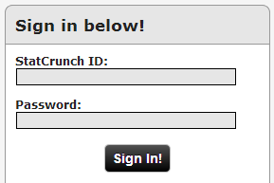
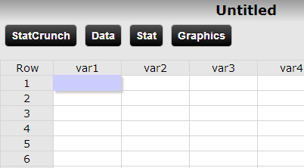
Example
Task: Compute average and median salary for 2011 MLB players.
Visit www.statcrunch.com/mobile and login:

Slide 11
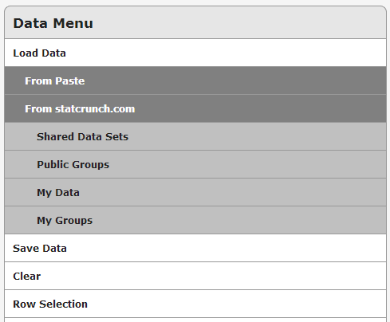
Loading Data
can load same “My Data” loaded into regular StatCrunch
can load “Shared Data Sets”
can not load data from the web or from the local device

Slide 12
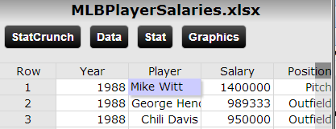
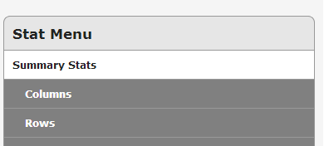
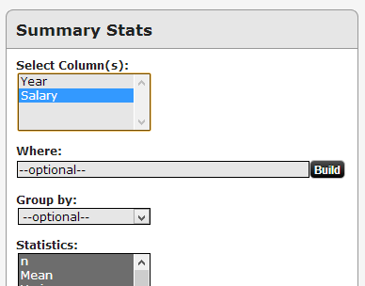
Computing Summary Stats

Slide 13
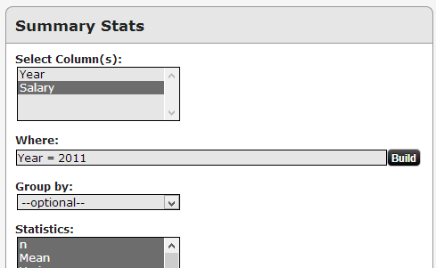
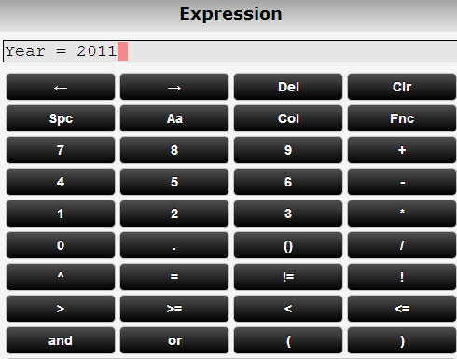
Selecting the Right Data
Average salary: $1,916,817 Median salary: $565,000
Average salary 2011: $3,305,054 Median salary 2011: $1,175,000

Slide 14
StatCrunch Mobile Project
27 UG Students with a variety of background in Fall 2012
Students received Nokia 900 phones (Windows Phone 7.5) and used StatCrunch mobile as part of a TLTC grant
=> Treatment
28 UG students with similar background in Spring 2012
Students used ‘regular’ StatCrunch
=> Control
Same textbook, similar material, similar lecture notes, similar assignments, but “treatment” used StatCrunch (mobile) virtually every class, “control” mainly for HW

Slide 15
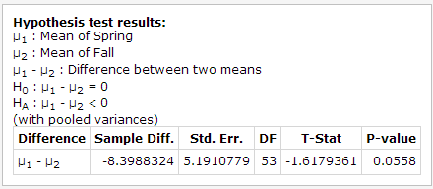
Two-Sample Difference of Means ^{(*)}
(*) includes all grades, including 3 students who did not properly finish the course

Slide 16
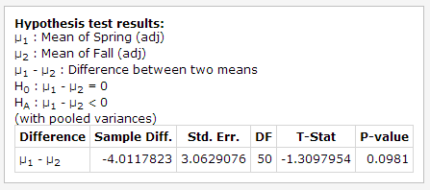
Two-Sample Difference of Means^{(**)}
(**) include all but three (lowest) grades (3 students did not finish the course)

Slide 17
Typical Questions
Does attending college pay off? Specifically, is there a relation between the highest degree of education and the income level in the US?
Is there a relation between “average life expectancy” and “literacy rate” in various countries? If so, could you predict the life expectancy in a country based on its literacy rate? Does that imply that reading more makes you live longer?
Conventional wisdom has it that the normal temperature of a person is 98.6º F. Is that true? Do men and women have different body temperatures? Is there a relation between temperature and heart beat at rest?

Slide 18
Survey
Administered survey to measure student satisfaction (treatment only)
24 students responded (89%)

Slide 19
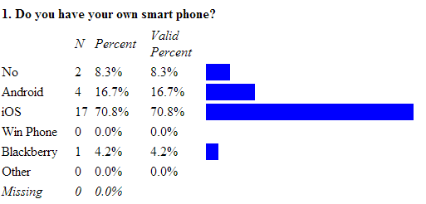
Survey Results

Slide 20
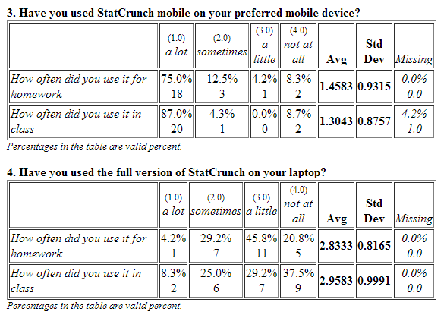
Survey Results

Slide 21
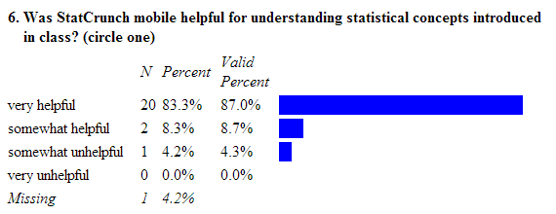
Survey Results

Slide 22
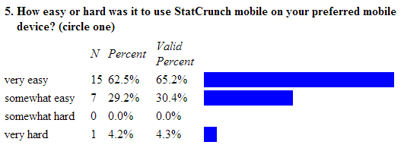
Survey Results

Slide 23
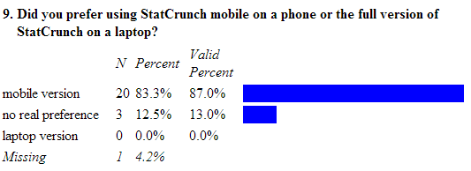
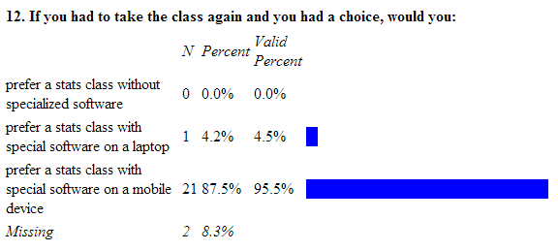
Survey Results

Slide 24
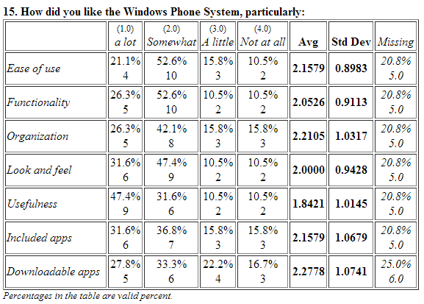
Survey Results

Slide 25
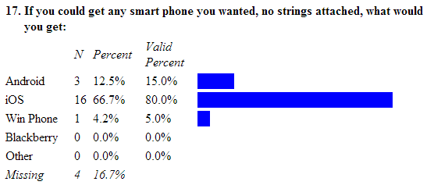
Survey Results

Slide 26
Survey Results
10. What is the best feature of StatCrunch mobile? [text response]
accessibility through the phone
does the math for you instead of memorizing all the formulas
easier & more convenient
helped me to understand almost everything
it is a quick and accurate way to find out data and reach a conclusion
it is easy to switch back and forth to the calculator
the effectiveness of saving time by doing calculations
[…]

Slide 27
Survey Results
11. What did you like least about StatCrunch mobile? [text response]
nothing
didn´t let you scroll through the data set
hard to understand at first
how it wasn´t necessary for me to memorize formulas and learn them because StatCrunch did everything for me.
it is tedious putting the #´s in
in the laptop you can view more #s at once but that´s it, no qualms about mobile
when you press the ¨Back¨ button you have to sign in again
[…]

Slide 28
Advantages of Smart Phones
Touch screen
Ease of use
Familiarity
Fixability
Portability
Connectedness (important if no campus Wifi)
No learning curve (for students)
No running out of battery

Slide 29
Disadvantages of StatCrunch mobile
Can not print
Can not copy-paste
Possibility to cheat
Steep learning curve
(for Instructors :-)

Slide 30
Discussion
StatCrunch mobile clearly preferred by students
Treatment group performed better than Control
Small sample only
No direct comparison within one semester
Getting a new smart phone might have made students more willing to experiment
Or
Mobile apps have inherent advantages based on the easy to use touch interface and their ubiquity

Slide 31
Future Work
Compare StatCrunch vs Mobile in a larger study with groups in the same semester
Study other smart phone apps, such as Wolfram Alpha (for mobile)
Study the acceptance of faculty to smart phone based apps

