Slide 1
Using Statistics for Better Business Decisions
Justin Bateh and Bert G. Wachsmuth
Copyright © Justin Bateh and Bert G. Wachsmuth, 2016. All rights reserved.

Slide 2
Chapter 8 Linear Regression
Using Statistics for Better Business Decisions
Copyright © Justin Bateh and Bert G. Wachsmuth, 2016. All rights reserved.

Slide 3
Learning Objectives
Use regression analysis to predict the value of a dependent variable based on an independent variable
Evaluate the assumptions of regression analysis
Determine the correlation coefficient and describe its meaning
Use simple regression techniques to solve business problems and make recommendations
Ch 8: Linear Regression – Learning Objectives

Slide 4
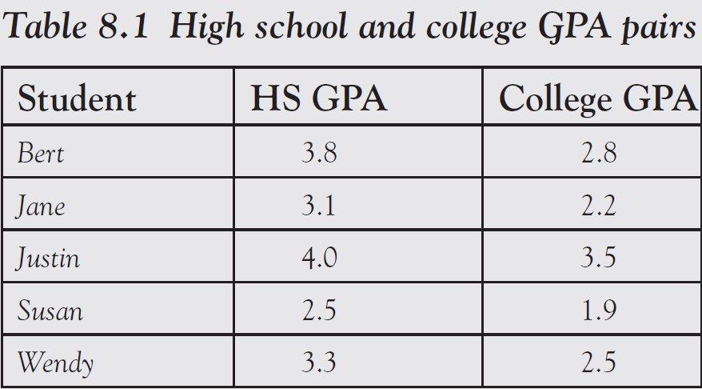
Example
Suppose that five students were asked their high school and
college GPA, with the answers shown in Table 8.1.
We want to know if high school and college GPA are related, and if they are related, can we use the high school GPA to predict the college GPA?
Ch 8: Linear Regression – Correlation Between Numerical Variables

Slide 5
Looking at the data it seems clear that:
The college GPA is always worse than the high school one
The smaller the high school GPA the smaller the college GPA
This seems to indicate a relationship but it seems difficult to quantify how strong the relationship is.
It also seems clear that if there was a relation, the high school GPA would be our independent variable, while the college GPA, occurring later in time, is the dependent one.
Ch 8: Linear Regression – Correlation Between Numerical Variables
Notes:
We will first discuss how to compute and interpret the so-called correlation coefficient to help decide whether two numerical variables are related or not.
The formulas we need might look pretty intense but when we see the examples they should become crystal clear.

Slide 6
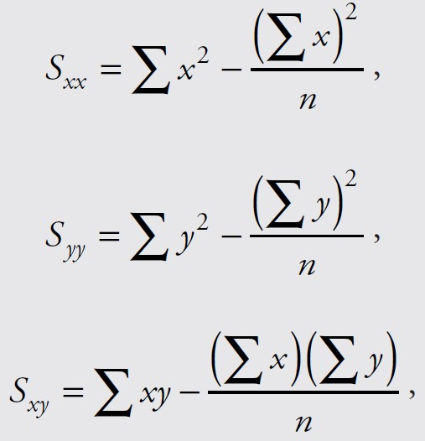
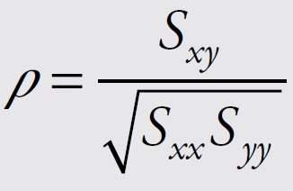
If our data is given in (x,y) pairs where x and y are numeric variables with x denoting the independent variable and y the dependent one, then compute the quantities:
where the “sigma” symbol indicates summation and n stands for the number of data points
With these quantities computed, the correlation coefficient ρ (rho) is defined as:
Ch 8: Linear Regression – Correlation Between Numerical Variables

Slide 7
Example
Compute the correlation coefficient for the data in Table 8.1 of high school (x) and college GPA (y).
To compute the correlation coefficient for our preceding GPA example we create a table containing both variables, with additional columns for their squares as well as their product, somewhat similar to computing the variance (see Table 8.2).
Ch 8: Linear Regression – Correlation Between Numerical Variables

Slide 8
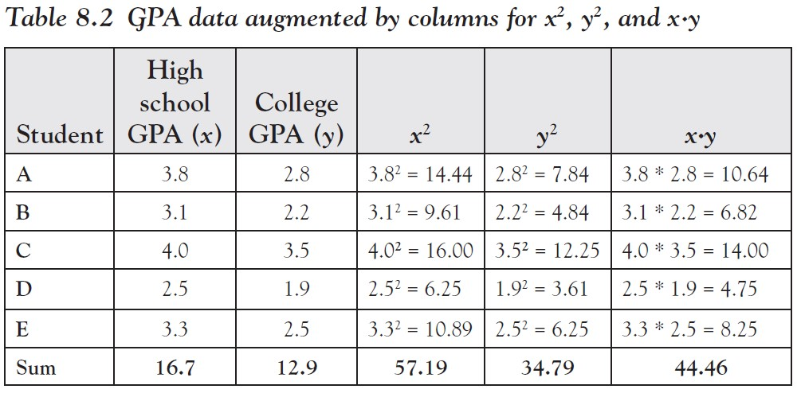
The last row contains the sum of the x’s, y’s, x-squared, y-squared, and x· y, which are precisely the quantities that we need to compute $S_{xx}$, $S_{yy}$, and $S_{xy}$.
Ch 8: Linear Regression – Correlation Between Numerical Variables

Slide 9
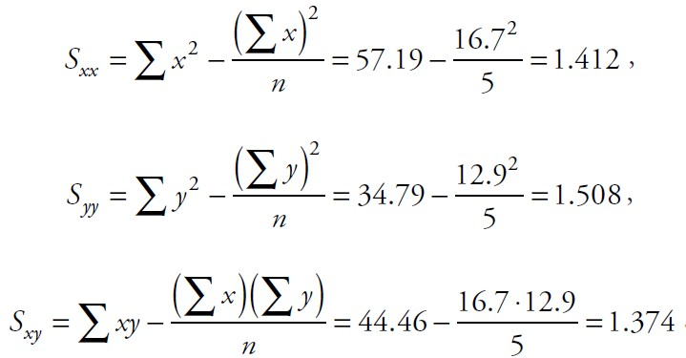
Thus:
Therefore, the correlation coefficient for this data:
Ch 8: Linear Regression – Correlation Between Numerical Variables

Slide 10
Correlation Coefficient ρ
Measures how strong a linear relationship exists between two numerical variables x and y
The correlation coefficient is always a number between −1.0 and +1.0.
If the correlation coefficient is close to +1.0, then there is a strong positive linear relationship between x and y.
If x increases, y also increases
If the correlation coefficient is close to −1.0, then there is a strong negative linear relationship between x and y.
If x increases, y will decrease
The closer to zero the correlation coefficient, the lesser the extent of the linear relationship between x and y.
Ch 8: Linear Regression – Correlation Between Numerical Variables

Slide 11
Example
Determine if there is a linear relationship between high school and college GPA for the data in Table 8.1.
We have already computed the correlation coefficient to be ρ = 0.9416, which is very close to +1.
Therefore, we can conclude that there indeed is a strong positive relationship between high school GPA and college GPA in this particular example.
Ch 8: Linear Regression – Correlation Between Numerical Variables

Slide 12
While the preceding table certainly helps in computing the correlation coefficient, it is still a lot of work, especially if there are several (x, y) data points.
Even using Excel to help compute Table 8.2 seems a lot of work.
However, Excel has a convenient function to quickly compute the correlation coefficient without the need for a complicated table.
The Excel built-in function
=correl(x_range, y_range)
returns the correlation coefficient of the cells in x_range (for the x values) and the y_range (for the y values)
All cells must contain numbers, and no cell should be empty.
Ch 8: Linear Regression – Using Excel to Compute the Correlation Coefficient

Slide 13
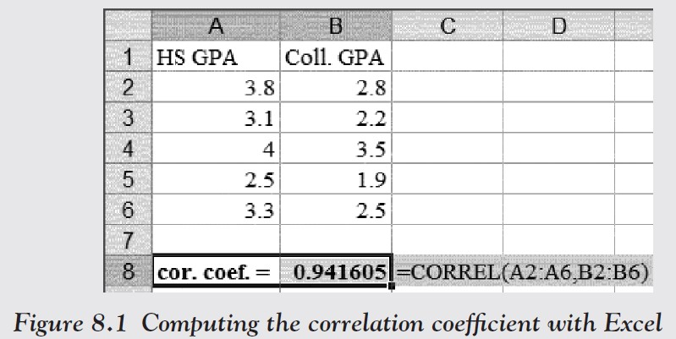
Example
To use this Excel function to compute the correlation coefficient for the previous GPA example, we would enter the data and the formulas as shown in Figure 8.1.
It shows the correlation coefficient computed by Excel to be 0.9416, which is—of course—the same as we computed manually before.
Ch 8: Linear Regression – Using Excel to Compute the Correlation Coefficient

Slide 14
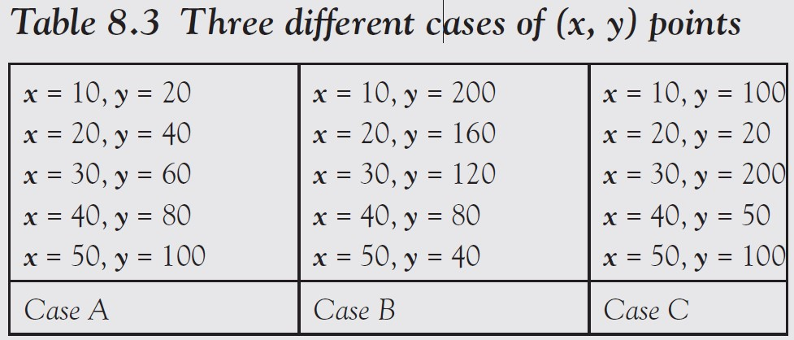
Example
Consider the following artificial examples: Some data for x and y (which have no particular meaning right now) are listed in Table 8.3 for three different cases.
Guess the correlation coefficient in each case and then confirm your guess by computing it exactly (perhaps with Excel).
Ch 8: Linear Regression – Using Excel to Compute the Correlation Coefficient

Slide 15
Just looking at Table 8.3 it seems pretty obvious that:
In case A, there should be a strong positive relationship between x and y, so we expect the correlation coefficient to be close to +1.
In case B, there should be a strong negative relationship between x and y, so we expect the correlation coefficient to be close to −1.
In case C, there seems to be no apparent relationship between x and y, so the correlation coefficient should be close to zero (it is hard to say whether it is positive or negative).
Ch 8: Linear Regression – Using Excel to Compute the Correlation Coefficient

Slide 16
Indeed, using Excel to compute each correlation coefficient confirms:
In case A, the coefficient equals 1.0, that is, there is a strong positive correlation—in fact, in this easy case we can see that the linear relation between x and y is y = 2x.
In case B, the coefficient equals −1.0, that is, there is a strong negative correlation—the actual equation relating x with y is a little harder to see, though (but not impossible, try to guess it).
In case C, the coefficient is 0.069, which is close to zero, so there is no correlation.
Ch 8: Linear Regression – Using Excel to Compute the Correlation Coefficient
Notes:
The preceding cases are artificial; real-life data is usually not so clear-cut.

Slide 17
Example
In a previous section we looked at an Excel data set that shows various information about employees.
Here is the spreadsheet data, but this time the salary is left as an actual number instead of a category.
www.betterbusinessdecisions.org/data/employeenumeric.xls
Download this file into Excel and find out whether there is a linear relationship between the salary and the years of education of an employee.
Ch 8: Linear Regression – Using Excel to Compute the Correlation Coefficient

Slide 18
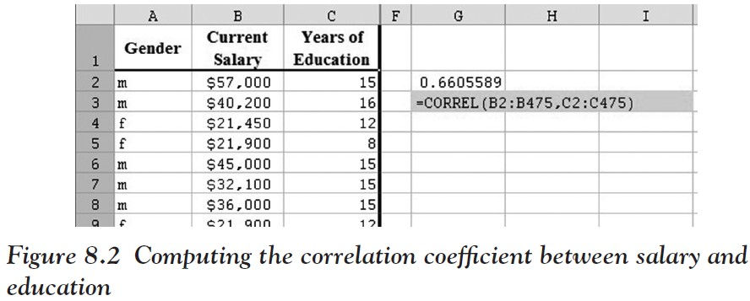
Download the preceding spreadsheet and start Excel with that worksheet as input.
Click on an empty cell in your spreadsheet and enter the formula:
=CORREL(B2:B475,C2:C475),
where the first input range B2:B475 corresponds to the salary
while the second range C2:C475 corresponds to “Years of Education”
Excel will compute the correlation coefficient, which turns out to be 0.66.
Since the correlation coefficient is 0.66, it means that there is indeed some positive relation between years of schooling and salary earnings.
But since the value is not that close to +1.0, the relationship is not super strong.
Ch 8: Linear Regression – Using Excel to Compute the Correlation Coefficient

Slide 19
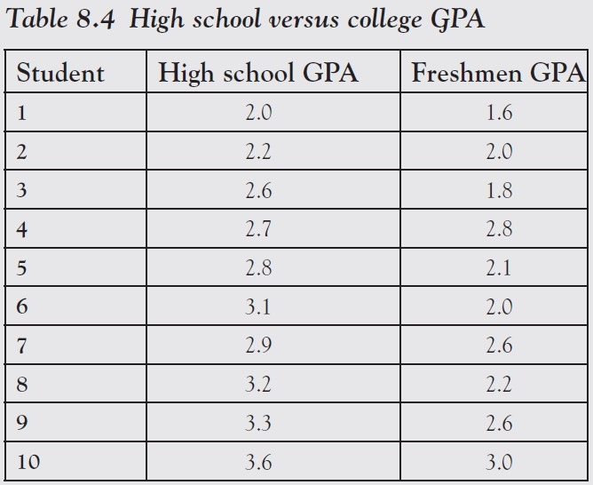
Example
The results:
A group of 10 students was selected at random and asked for their high school GPA and their freshmen GPA in college the subsequent year.
Visualize this data to see a potential relation between the two variables.
Ch 8: Linear Regression – Scatter Plots
Notes:
So far we have seen how to determine whether two variables are independent (chi-square test for categorical variables) or linearly related (correlation coefficient for numerical variables). In this section we will investigate the relationship, if any, graphically.
We have already defined dependent and independent variables but in our current context we say that if there is a relationship between two variables in such a way that knowledge of the first allows the computation or prediction of the second, then the first variable is called the independent variable—usually denoted by x—while the second is called the dependent variable—usually denoted by y.
As before, the independent variable often refers to a time prior to that of the dependent variable.

Slide 20
Since students go to high school prior to going to college, the high school GPA refers to a time before that of the freshmen GPA.
Therefore the high school GPA is the independent variable, called x, while the freshmen GPA is the dependent variable y.
That makes sense since it is conceivable that the high school GPA determines the freshmen GPA but not the other way round.
With our choice of x and y, Table 8.4 translates into a series of (x, y) data points:
(2.0, 1.6), (2.2, 2.0), (2.6, 1.8), (2.8, 2.1), (3.1, 2.0), (2.9, 2.6), (3.2, 2.2), (3.3, 2.6), (3.6, 3.0)
Ch 8: Linear Regression – Scatter Plots

Slide 21
We can now plot these points in a standard Cartesian coordinate system.
Start as usual with Microsoft Excel, with an empty spreadsheet.
Label the first two columns “High School GPA” and “College GPA,” respectively. Do not worry if you cannot see the first label in its entirety.
Enter the data in columns, each high school GPA in the first column and the corresponding college GPA in the second.
Use the mouse to mark all data, labels as well as numbers.
Then click on the “Insert” ribbon and select “XY (Scatter)” as chart type.
Ch 8: Linear Regression – Scatter Plots

Slide 22
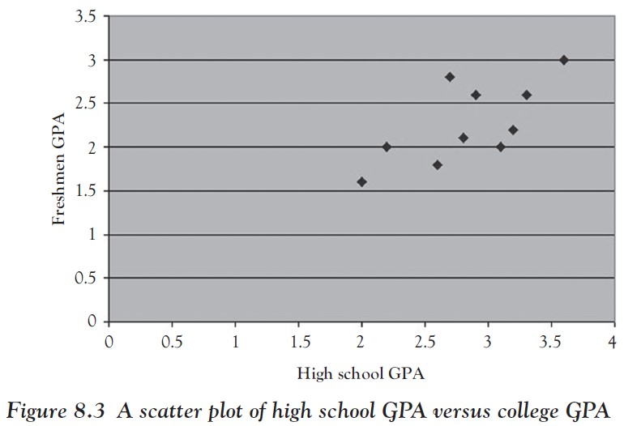
The resulting chart:
You can customize the chart to make it look more to your liking.
For example, we can double-click on the “X” axis (horizontal axis) to change the scale so that the minimum value starts at 1.8.
We can also click on the “Y” axis (vertical) to change its scale so that it also starts at 1.4.
After all, there are no values less than 1, so why not start the axis at that number instead of at zero?
Ch 8: Linear Regression – Scatter Plots

Slide 23
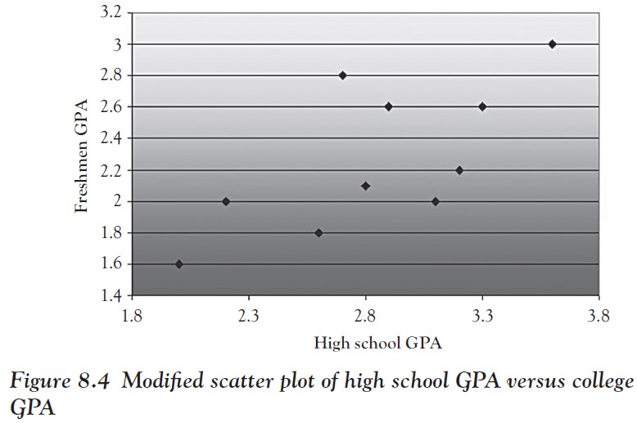
Possible final version of the chart (where we have also changed the background color):
There is indeed some loose relationship between high school and college GPA.
The dots are not randomly distributed, and they seem to follow some pattern:
low high school GPAs result in low college GPAs
higher high school scores result in better college performance
all college grades are somewhat worse than high school grades
the dots seem to cluster around an imaginary diagonal line
If we computed the correlation coefficient it would come out to be 0.69665, confirming that there is some linear relationship between the variables but not a strong one.
Ch 8: Linear Regression – Scatter Plots
Notes:
In the next section we learn a precise way to determine the linear equation relating x and y and to use the projected relation to make predictions for values that are not part of the original data set.

Slide 24
Example
A group of 10 students was selected at random and asked for their high school GPA and their freshmen GPA in college the subsequent year. The results are shown in Table 8.4.
Is there a linear relationship between the high school GPA and the freshmen GPA? If so predict the freshmen GPA for a student with a high school GPA of, say, 3.4.
Ch 8: Linear Regression – Linear Regression
Notes:
This time we again want to look at data from two variables that are possibly related, but we want to determine the exact nature of this relationship, if any, and develop some formulas that will allow us to make predictions. Let us start with the same example we have used before.

Slide 25
We plotted the data in a scatter plot in Figure 8.4 where data seem to cluster around some imaginary diagonal line that, somehow, fits the data points in the “best possible” way.
Figure 8.5 shows three candidates for such a line.
Ch 8: Linear Regression – Linear Regression

Slide 26
In each case we have drawn a line that somehow passes through the data points. It seems clear that:
No straight line can pass through all data points.
Line 1 does not fit the data points very well because too many points are to the right, or below that line.
Line 2 does not fit the data points very well because too many points are above the line.
Line 3 does not fit the data points perfectly, but seems to have the best fit of these three lines.
Ch 8: Linear Regression – Linear Regression

Slide 27
Mathematically speaking, the line that gives the “best fit” is that line where the sum of the squares of the differences to all data points has the smallest possible value (this can be proved in multivariate calculus).
Least-squares regression line – the line that fits best
Least-squares linear regression – the process of finding it
Ch 8: Linear Regression – Linear Regression

Slide 28
Our goal is to determine the equation of the “least-squares regression” line.
In other words, we want to find the equation of a line that happens to be called “least-squares regression line” and that fits the data best.
We know from previous algebra classes that any line has the equation:
y = mx + b
m is the slope of the line
b is the interception of the line with the y-axis
We also recall from high school that lines that go up have a positive slope (as the lines 1, 2, and 3 in Figure 8.5), while lines with negative slopes go down.
Ch 8: Linear Regression – Least-squares Regression Line “Manually”

Slide 29
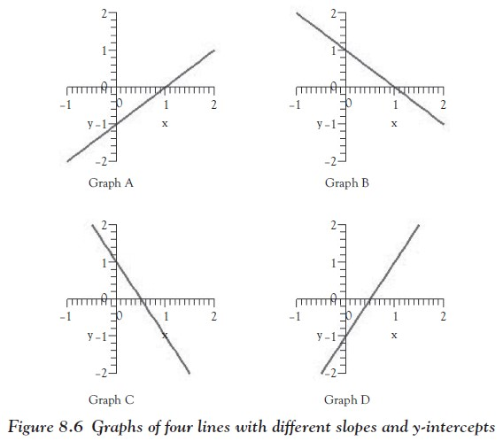
Example
Suppose we have four equations of lines as follows:
y = x − 1
y = 2x − 1
y = −x + 1
y = −2x + 1
Match these equations to the graphs shown in Figure 8.6
Ch 8: Linear Regression – Least-squares Regression Line “Manually”

Slide 30
According to the equations of the lines, we know:
y = x − 1 is a line with slope 1 (going up)
and y-intercept −1.
y = 2x − 1 is a line with slope 2 (going up more) and y-intercept −1.
y = −x + 1 is a line with slope −1 (going down) and y-intercept 1.
y = −2x + 1 is a line with slope −2 (going down more) and y-intercept 1.
Ch 8: Linear Regression – Least-squares Regression Line “Manually”

Slide 31
Graphs A and D show lines going up, so both have positive slopes.
Both also intersect the y-axis at −1, so both have y-intercept −1.
But the line in graph D is steeper, so it has a bigger slope.
Thus, Equation 1 matches graph A while Equation 2 matches graph D.
Ch 8: Linear Regression – Least-squares Regression Line “Manually”

Slide 32
Similarly, both graphs B and C have negative slopes and y-intercept +1
But line C goes down faster and thus has a more negative slope
Therefore, Equation 3 matches graph B while Equation 4 matches graph C.
Ch 8: Linear Regression – Least-squares Regression Line “Manually”

Slide 33
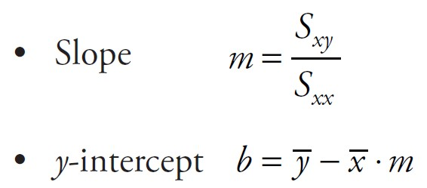
So to determine the least-squares regression line we must first and foremost find the equation of a line
This means we need to identify its slope m and y-intercept b.
As it happens, the slope is related to the quantities $S_{xx}$, $S_{yy}$, and $S_{xy}$ we computed in the “Linear Regression” section while the y-intercept is related to the averages (means) of x and y.
The formulas are:
$\overline{x }$= $\frac{1}{n}\sum{x_{i}}$ is the mean of the x values
$\overline{y }$= $\frac{1}{n}\sum{y_{i}}$ is the mean of the y values
Ch 8: Linear Regression – Least-squares Regression Line “Manually”
Notes:
In this text we will not try to determine how these formulas come about. That would be done in more advanced mathematical courses. We will be content using these equations, as in our next example.

Slide 34
Example
Consider the data in Table 8.4 of high school versus college GPA and compute the equation of the least-squares regression line.
Also compute the correlation coefficient.
Ch 8: Linear Regression – Least-squares Regression Line “Manually”

Slide 35
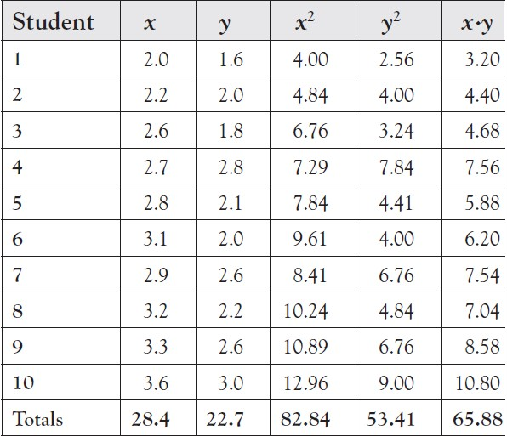
Just as we did for the correlation coefficient in the “Correlation Between Numerical Variables” section, we create the following table.
Ch 8: Linear Regression – Least-squares Regression Line “Manually”

Slide 36
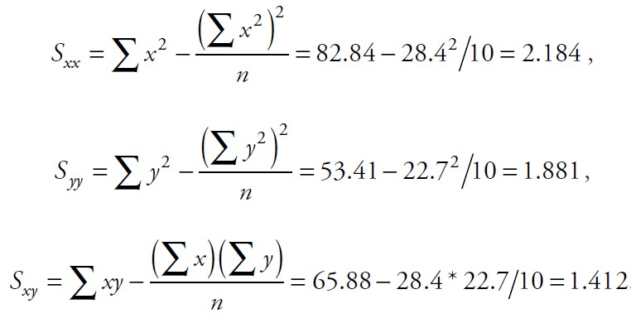
Thus, we can compute:
Ch 8: Linear Regression – Least-squares Regression Line “Manually”

Slide 37
Since we already know the sums of x and of y, we can also quickly compute:
But now the difficult work is over and we can determine the slope and y-intercept, as well as the correlation coefficient:
Thus, the equation of our least-squares regression line, relating high school GPA (x) and college GPA (y) is y = 0.645 * x + 0.4382
And the correlation coefficient of 0.6966 indicates that the relation is not very strong
Ch 8: Linear Regression – Least-squares Regression Line “Manually”
Notes:
We can now use our computed equation to make predictions.

Slide 38
Example
Using the data in Table 8.4 for high school and college GPAs, predict the college GPA for a student with a high school GPA of 3.7.
Do you think your prediction is valid?
Ch 8: Linear Regression – Least-squares Regression Line “Manually”

Slide 39
First, note that x = 3.7 is not one of the original high school GPA scores. But we know the general relationship between x and y (the equation of the least-squares regression line):
y = 0.645 ∗ x + 0.4382,
which we can use for our prediction:
If x = 3.7 then y = 0.645 ∗ 3.7 + 0.4382 = 2.8247
Thus, our prediction is that a high school GPA of 3.7 will result in a college GPA of 2.83, approximately.
Moreover, because of our correlation coefficient, we are somewhat confident that our prediction is accurate.
Ch 8: Linear Regression – Least-squares Regression Line “Manually”
Notes:
This was a lot of work but before we use Excel to simplify the computations, let us do one more example manually.

Slide 40
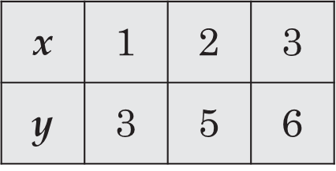
Example
Suppose some (made-up) data for two variables x and y are as shown in the table.
Use this data to predict the y value for x = 5 and state how confident you are in your prediction.
Ch 8: Linear Regression – Least-squares Regression Line “Manually”

Slide 41
We create a table of x, y,${ x}^{2}$, and so on values, draw a scatter plot, compute $S_{xx}$, $S_{yy}$, and so forth, and finish up with the equation of the line.
Figure 8.7 shows the results.
Ch 8: Linear Regression – Least-squares Regression Line “Manually”

Slide 42
But now the difficult work is over and we can compute the slope and y-intercept, as well as the correlation coefficient, as follows:
Slope m = $S_{xy}$/$S_{xx}$ = 3/2 = 1.5,
y-intercept b = (mean of y) − (mean of x) ∗ m = 4.667 − 2 ∗ 1.5 = 1.667,
Correlation coefficient r = 3/sqrt(2 ∗ 4.667) = 0.982
Thus, the equation of our least-squares regression line relating x and y is y = 1.5 x + 1.667.
Thus, if x = 5 we compute our prediction to be y = 1.5 ∗ 5 + 1.667 = 9.167 and since the correlation coefficient is 0.982, we know that the relation is very strong.
Therefore, we are pretty sure about our prediction.
Ch 8: Linear Regression – Least-squares Regression Line “Manually”
Notes:
Note that we are basing our prediction or forecast on only three data points. Such a small sample is generally not adequate for good predictions.

Slide 43
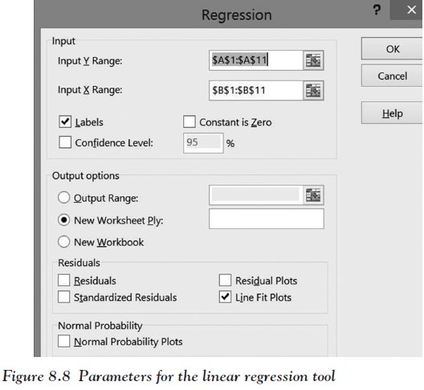
Start Excel as usual and enter the data from the preceding GPA example.
From the “Tools” menu, select the “Data Analysis …” menu item and choose “Regression.”
In the “Regression” dialog window use the selector tools and select the X and Y range (be careful, the first range to choose is the Y range, i.e., the dependent variable, not X, i.e., the independent one). If you include labels in the X, Y ranges, make sure to check the “Labels” box.
To get a scatter plot including the least-squares regression line, make sure to check “Line Fit Plots” in the “Residuals” category
Click OK—you should see a lot of output, much of it mysterious, grouped into regions.
Ch 8: Linear Regression – Least-squares Regression Line “Automatically”

Slide 44
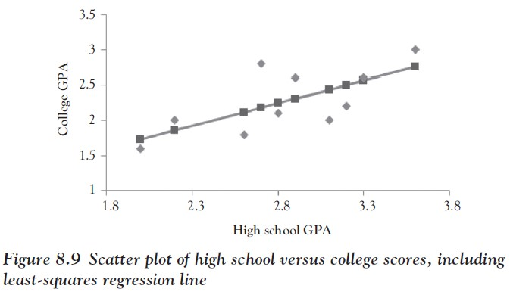
The Chart: This consists of a scatter plot in the X,Y coordinate system.
At the very least you want to connect the computed points with the least-squares regression line: double-click on the chart
Then click on the data points and select “Solid line” from the options on the right.
Ch 8: Linear Regression – Least-squares Regression Line “Automatically”

Slide 45
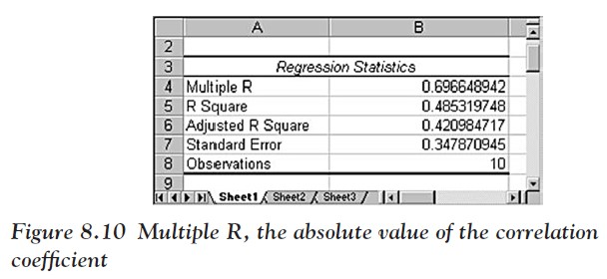
The Regression Statistics: The most important number here is “Multiple R,” which has the value of 0.6966 in this case.
In fact, this number is the absolute value of our previous correlation coefficient.
If we square it, the result, called “R Square,” tells us how much percentage of the variation of the dependent variable (y) is explained by the independent variable (x).
In our case, 48 percent of the variation in college GPA can be explained by the high school GPA.
Ch 8: Linear Regression – Least-squares Regression Line “Automatically”

Slide 46
Note that “multiple R” is always between 0 and 1, and closer to 1 indicates a stronger relation.
In our example the multiple R is reasonably close to 1
implies that the two variables are indeed somewhat linearly (positive or negative) related (and the least-squares regression line indeed fits the data points relatively well)
Ch 8: Linear Regression – Least-squares Regression Line “Automatically”

Slide 47
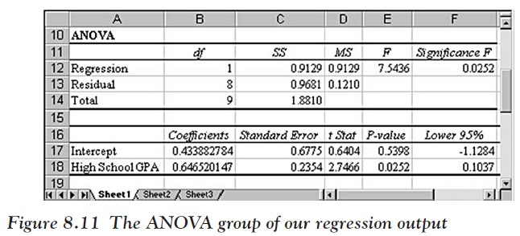
The Analysis of Variance (“ANOVA”) Section:
The two most important numbers in this section are the “Coefficients” for the “Intercept” and the “High School GPA.”
In this case “Intercept” is 0.4339 and “High School GPA” is 0.6465 (rounded).
These two numbers are the slope and intercept of the least-squares regression line.
Ch 8: Linear Regression – Least-squares Regression Line “Automatically”

Slide 48
In other words, the actual equation of the least-squares regression line:
y = 0.6465 · x + 0.4339
That equation of the line can be used for predictions.
For example, if we want to know the college GPA (y) for a student with a high school GPA (x) of 3.4 we substitute x = 3.4 in the preceding equation and we find the corresponding y value to be y = 0.6465 ∗ 3.4 + 0.4339 = 2.632.
Note that from this section we see that the slope is positive, which means that the correlation coefficient is also positive.
Ch 8: Linear Regression – Least-squares Regression Line “Automatically”

Slide 49
The “Significance F” tells us whether the results are statistically significant
It should be small (less than 0.05).
It gives the p-value for the testing the null hypothesis $H_{0}$: slope = 0
i.e., the true regression line is really a flat line) against the alternative $H_{0}$: slope ≠ 0
If that p-value is small enough, we get to reject $H_{0}$ and accept the alternative
i.e., the regression equation does a better job of predicting the dependent variable rather than using a line with slope 0)
Ch 8: Linear Regression – Least-squares Regression Line “Automatically”

Slide 50
The “Residual Output” Section: This is not important for us in this context, so we ignore it.
Now we can also answer the original question:
Based on our data and a least-squares regression analysis of that data, we can predict that a student with a high school GPA of 3.4 will have a college GPA of approximately 2.632.
Since the correlation coefficient is 0.69, we are somewhat confident that our prediction is accurate.
Ch 8: Linear Regression – Least-squares Regression Line “Automatically”

Slide 51
Example
In the attached Excel spreadsheet you will find data about the literacy rate (percentage of people who can read) and average life expectancy of over 200 countries in the world, based on 2014 data. Load that data into Excel and perform a least-squares regression analysis to see if there is a linear relationship between literacy rate and average life expectancy.
If you find that there is a relation, determine what would happen to the life expectancy of people in Afghanistan if its literacy rate could be raised to, say, 60 percent (from its current value of 29 percent).
www.betterbusinessdecisions.org/data/life_literate.xls
Ch 8: Linear Regression – Least-squares Regression Line “Automatically”

Slide 52
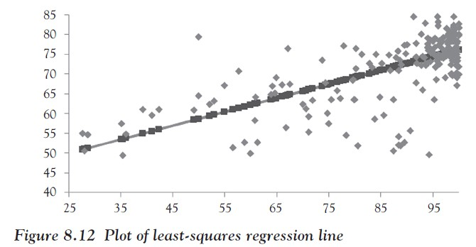
We use Excel’s “regression” tool, using the literacy rate as the independent variable (x) and life expectancy as the dependent one (y).
The least-squares regression line fits the data quite well as you can see from the scatter plot in Figure 8.12 as well as from the correlation coefficient of 0.67.
Ch 8: Linear Regression – Least-squares Regression Line “Automatically”

Slide 53
The coefficients of the least-squares regression line:
41.17541984 (intercept) and 0.349593582 (slope)
so that the regression line has the equation y = 0.3496 · x + 41.1754
This means that if a country such as Afghanistan had a literacy rate of y = 60 percent, we would predict an average life expectancy of approximately y = 0.3496 · 60 + 41.1754 = 62.1514
Or approximately 62 years (as opposed to its current life expectancy of 50.5 years with a literacy rate of 28.1 percent)
Ch 8: Linear Regression – Least-squares Regression Line “Automatically”
Notes:
Note: This does not mean that reading books causes people to live longer. After all, at the beginning of Chapter 7 we mentioned that correlation does not necessarily imply causation.
But what it does mean is that if a country can raise its literacy rate, probably through a wide variety of programs and policy decisions, then a beneficial side effect seems to be that the average life expectancy goes up proportionally as well.
It also means that if a country—perhaps for political reasons—does not make its life expectancy rate public, but its literacy rate is known, we can obtain a pretty good estimate of that life expectancy based exclusively on the literacy rate of the country.

Slide 54
Excel Demonstration
Company P, the large manufacturer of paper products, was asked by one of its retail clients to provide an analysis on the role that shelf space has on the sales of a product. The marketing manager of a large retail chain that purchases paper products from Company P has the business objective of using shelf space most efficiently. Toward that goal, she would like to use shelf space to predict the sales of a specialty paper plate product.
Data collected from a random sample of 12 equal-sized stores are presented in Table 8.5.
Ch 8: Linear Regression – Excel Demonstration

Slide 55
You have been asked to answer the following questions.
Produce a line fit plot to demonstrate the trend in shelf space and sales along with the predicted path.
Is there a strong relationship between shelf space and sales?
Can you tell us how much shelf space accounts for the variation of sales?
Is there is a significant relationship between shelf space and sales?
Develop a linear equation for predicting sales, given shelf space.
Predict the weekly sales of the specialty paper product for stores with 7 ft. of shelf space for the paper product.
Ch 8: Linear Regression – Excel Demonstration

Slide 56
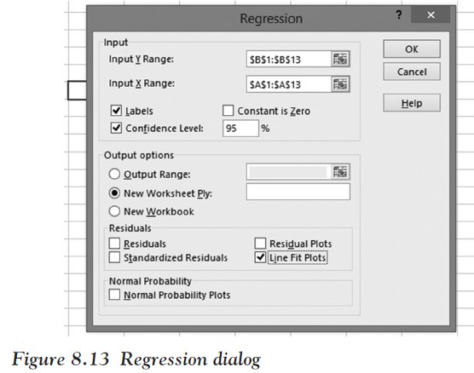
Step 1:
Enter the data into a new Excel worksheet in two columns, including column titles.
Step 2:
Click on Data, then DATA Analysis, and choose Regression.
Step 3:
Fill in the Regression dialog box shown in Figure 8.13 and then click OK.
Ch 8: Linear Regression – Excel Demonstration

Slide 57
For the Y range, include the data in the Sales category (include the label).
For the X range, include the data in the Shelf Space category (include the label).
Check the Labels box since we have to include the label.
Check the Confidence Level box and leave it as the default 95 percent.
Check the Line Fit Plot box to display the least-squares regression line.
Ch 8: Linear Regression – Excel Demonstration

Slide 58
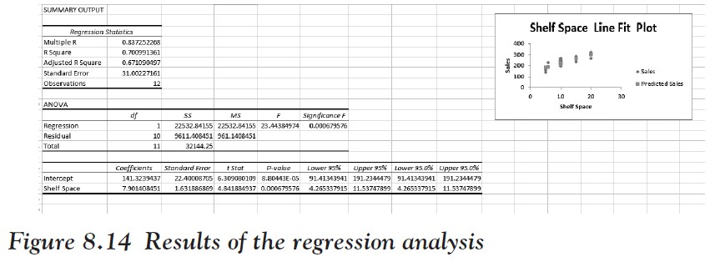
Step 4:
Interpret the results shown in Figure 8.14.
Figure 8.14 Results of the regression analysis
Ch 8: Linear Regression – Excel Demonstration

Slide 59
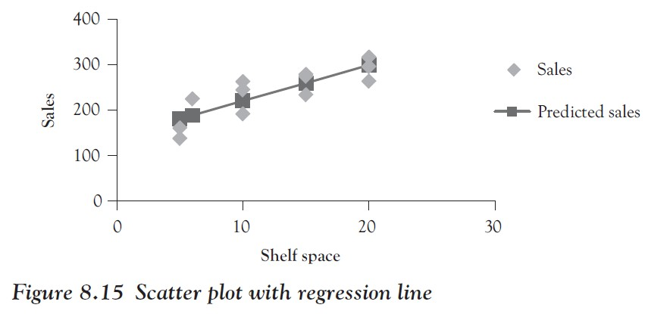
Produce a line fit plot to demonstrate the trend in shelf space and sales along with the predicted path.
Figure 8.15 shows the scatter plot with the least-squares regression line.
Ch 8: Linear Regression – Excel Demonstration
Notes:
Now we can answer the aforementioned questions.

Slide 60
Is there a strong relationship between shelf space and sales?
We see from Figure 8.14 that “Multiple R” is 0.837252268.
This is close to 1 so that there is a fairly strong correlation between shelf space and sales.
From the plot in Figure 8.15 we see that the regression line has a positive slope, so that the correlation is fairly strong and positive.
Ch 8: Linear Regression – Excel Demonstration
Notes:
Now we can answer the aforementioned questions.

Slide 61
Is there a significant relationship between shelf space and sales?
From Figure 8.14 we see that the “Significance F” value is 0.000679576, which is less than our requested alpha level of 0.05, indicating that there is a significant relationship between shelf space and sales.
Figure 8.14 Results of the regression analysis
Ch 8: Linear Regression – Excel Demonstration

Slide 62
Develop a linear equation for predicting sales, given shelf space.
We see from Figure 8.14 that the intercept coefficient is 141.3239437 and the shelf space coefficient, or slope, is 7.901408451. Thus, our least-squares regression line is y = 141.324 + 7.901 x.
Figure 8.14 Results of the regression analysis
Ch 8: Linear Regression – Excel Demonstration

Slide 63
Predict the weekly sales of the specialty paper product for stores with 7 ft. of shelf space for the paper product.
We just found the equation of our least-squares regression line to be y = 141.324 + 7.901 x.
Thus, we substitute 7 for x in the equation to get: y = 141.324 + 7.901 · 7 = 196.634.
Thus, if we gave the product 7 ft. of shelf space we can expect sales to be around $196,000.
Ch 8: Linear Regression – Excel Demonstration
Notes:
This helps a business person to optimize the use of shelf space so that products that will result in the highest sales are given the most space on shelves.

