Slide 1
Using Statistics for Better Business Decisions
Justin Bateh and Bert G. Wachsmuth
Copyright © Justin Bateh and Bert G. Wachsmuth, 2016. All rights reserved.

Slide 2
Chapter 3 Numerical Data Summary
Using Statistics for Better Business Decisions
Copyright © Justin Bateh and Bert G. Wachsmuth, 2016. All rights reserved.

Slide 3
Learning Objectives
Describe the properties of central tendency, variation, and shape in numerical data
Compute descriptive summary measures for a population
Construct and interpret a box plot
Ch 3: Numerical Data Summary – Learning Objectives

Slide 4
Mean
Represents the average of all observations
Describes the “quintessential” number of your data by averaging all numbers collected
Formula for computing the mean:
In statistics, two separate letters are used for the mean:
Greek letter μ (mu) – used to denote the mean of the entire population, or population mean
Symbol $\overline{x}$(read as “x bar”) – used to denote the mean of a sample, or sample mean
mean = (sum of all measurements)/(number of measurements)
Ch 3: Numerical Data Summary – Measures of Central Tendency – Mean, Median, Mode
Notes:
While charts are commonly very useful to visually represent data, they are inconvenient for the simple reason that they are difficult to display and reproduce. It is frequently useful to reduce data to a couple of numbers that are easy to remember and easy to communicate, yet capture the essence of the data they represent.
The mean, median, and mode are our first examples of such computed representations of data.

Slide 5
Another way to show how the mean is computed:
$n$ stands for the number of measurements
${\text{x}}_{i}$ stands for the individual i-th measurement
Greek symbol sigma ∑ stands for “sum of”
This formula is valid for computing either the population mean μ or the sample mean $\overline{x}$.
Ch 3: Numerical Data Summary – Measures of Central Tendency – Mean, Median, Mode
Notes:
Of course, the idea—ultimately—is to use the sample mean (which is usually easy to compute) as an estimate for the population mean (which is usually unknown). For now, we will just show examples of computing a mean, but later we will discuss in detail how exactly the sample mean can be used to estimate the population mean.

Slide 6
Example
A sample of seven scores from people taking an achievement test was taken.
Find the mean if the numbers are: 95, 86, 78, 90, 62, 73, 89
The mean of that sample:
$\overline{\text{x}}$̅ = (95 + 86 + 78 + 90 + 62 + 73 + 89)/7 + 573/7 + 81.9
The mean applies to numerical variables, and in some situations to ordinal variables.
Does not apply to nominal variables
Ch 3: Numerical Data Summary – Measures of Central Tendency – Mean, Median, Mode

Slide 7
Median
Number from a population or sample chosen so that half of all numbers are larger and half of the numbers are smaller than that number
The computation is different for an even or odd number of observations.
Important: Before you try to determine the median you must first sort your data in ascending order.
Ch 3: Numerical Data Summary – Measures of Central Tendency – Mean, Median, Mode
Notes:
Another, and in some sense better, measure of central tendency is the median, or middle number.

Slide 8
Example
Compute the median of the numbers 1, 2, 3, 4, and 5.
The numbers are already sorted, so that it is easy to see that the median is 3 (two numbers are less than 3 and two are bigger).
Ch 3: Numerical Data Summary – Measures of Central Tendency – Mean, Median, Mode

Slide 9
Example
Compute the median of the numbers 1, 2, 3, 4, 5, and 6.
The numbers are again sorted, but neither 3 nor 4 (nor any other of the numbers) can be the median.
The median should be somewhere between 3 and 4.
When there is an even number of numbers, the median is computed by taking the “middle between the two middle numbers.”
In our case the median, therefore, would be 3.5 since that is the middle between 3 and 4, computed as (3 + 4)/2.
Note that indeed three numbers are less than 3.5, and three are bigger, as the definition of the median requires.
Ch 3: Numerical Data Summary – Measures of Central Tendency – Mean, Median, Mode

Slide 10
For larger data sets, the median can be selected as follows:
Sort all observations in ascending order.
If $n$is odd, pick the number in the $\frac{n+1}{2}$ position of your data.
If $n$ is even, pick the numbers at positions $\frac{n}{2}$ and $\frac{n}{2}$ + 1 and find the middle of those two numbers.
This does not imply that the median is $\frac{n+1}{2}$ (if $n$ is odd) but rather that the median is that number which can be found at position ($n$ + 1)/2.
Median applies to numerical variables, and in some situations to ordinal variables.
Does not apply to nominal variables
Ch 3: Numerical Data Summary – Measures of Central Tendency – Mean, Median, Mode
Notes:
The median is usually easy to compute when the data is sorted and there are not too many numbers.
For unsorted numbers, in particular several numbers, the median becomes quite tedious, mainly because you have to sort the data first.

Slide 11
Mode
That observation that occurs most often
Easiest, most applicable, but least useful of the measures of central tendency
Example
Scores from a test were: 1, 2, 2, 4, 7, 7, 7, 8, 9. What is the mode?
The mode is 7, because that number occurs more often than any other number.
Ch 3: Numerical Data Summary – Measures of Central Tendency – Mean, Median, Mode
Notes:
As with the median, the mode is easy to find if the data is small and sorted.

Slide 12
Example
Scores from a test were: 1, 2, 2, 2, 3, 7, 7, 7, 8, 9. What is the mode?
This time the mode is 2 and 7, because both numbers occur thrice, more than the other numbers.
Sometimes variables that are distributed this way are called bimodal variables.
Ch 3: Numerical Data Summary – Measures of Central Tendency – Mean, Median, Mode

Slide 13
Pros and Cons of the Mode
Usefulness – it applies to any variable
For example, if your experiment contains nominal variables then the mode is the only meaningful measure of central tendency.
Problem – it is not necessarily unique, and mathematicians do not like it when there are more than one correct answers
Mean and median usually apply in the same situations, so it is more difficult to determine which one is more useful.
Ch 3: Numerical Data Summary – Measures of Central Tendency – Pros and Cons
Notes:
Since there are three measures of central tendency (mean, median, and mode), it is natural to ask which of them is most useful (and as usual the answer will be ... “it depends”).

Slide 14
Example
Suppose we want to know the average income of parents of students in this class. To simplify the calculations and to obtain the answer quickly, we randomly select three students to form a random sample.
Two possible scenarios:
Case 1: The three incomes were, say, $25,000, $30,000, and $35,000.
Case 2: The three incomes were, say, $25,000, $30,000, and $1,000,000.
Compute mean and median in each case and discuss which one is more appropriate.
Ch 3: Numerical Data Summary – Measures of Central Tendency – Pros and Cons

Slide 15
Actual computations are pretty simple:
In Case 1 the mean is $30,000 and the median is also $30,000.
In Case 2 the mean is $351,666 whereas the median is still $30,000.
Clearly we were unlucky in Case 2: one set of parents in this sample is very wealthy, but that is—probably—not representative for the students of the class.
However, we selected a random sample, so scenario 1 is equally likely as scenario 2.
Therefore, it seems that the median is actually a better measure of central tendency than the mean, especially for small numbers of observations.
Ch 3: Numerical Data Summary – Measures of Central Tendency – Pros and Cons
Notes:
In other words:
The mean is influenced by extreme values, more so than the median.
The median is more stable and is therefore the better measure of central tendency.

Slide 16
In other words:
The mean is influenced by extreme values, more so than the median.
The median is more stable and is therefore the better measure of central tendency.
Ch 3: Numerical Data Summary – Measures of Central Tendency – Pros and Cons

Slide 17
However, for large sample sizes the mean and the median tend to be close to each other anyway, and the mean does have two other advantages:
The mean is easier to compute than the median since it does not require sorted observations
This is true even if you use Excel: sorting numbers is time-consuming even for a computer, but in most cases the sample size is so small that we do not notice this.
The mean has nice theoretical properties that make it more useful than the median.
Ch 3: Numerical Data Summary – Measures of Central Tendency – Pros and Cons

Slide 18
Mean, Median, and Mode for Ordinal Variables
Example
Suppose you want to find out how students like a particular statistics lecture, so you ask them to fill out a survey, rating the lecture “great,” “average,” or “poor.” The 14 students in the class rank the lecture as:
great, great, average, poor, great, great, average, great, great, great, average, poor, great, average
Compute the mean, the mode, and the median.
Ch 3: Numerical Data Summary – Mean, Median, and Mode for Ordinal Variables
Notes:
Obviously the mode is “great,” since that is the most frequent response.

Slide 19
For the other measures of central tendency, introduce numerical codes for the responses.
For example:
“great” = 1, “average” = 2, and “poor” = 3
Then the preceding ordinal data is equivalent to
1, 1, 2, 3, 1, 1, 2, 1, 1, 1, 2, 3, 1, 2
Now it is easy to see that the average is 22/14 = 1.57 and the median is 1.
Instead of reporting mean and median as 1.57 and 1, respectively, it would be more appropriate to report that the median category was “great” (1), and the average category was between “great” (1) and “average” (2).
In a proper survey we would in fact list the code values together with the responses.
Ch 3: Numerical Data Summary – Mean, Median, and Mode for Ordinal Variables
Notes:
Of course the actual values for these central tendencies depend on the numerical code we are using for the original variables.
We would need to justify or at least mention the codes we are using in a report so that the answers can be put in proper context.

Slide 20
Likert scale
A sequence of items (responses) that are usually displayed with a visual aid, such as a horizontal bar, representing a simple scale
 | Strongly agree | Agree | Undecided | Disagree | Strongly disagree
The software I wanted was to find | 1 | 2 | 3 | 4 | 5
The checkout process was easy | 1 | 2 | 3 | 4 | 5
Figure 3.1 A survey with a Likert scale
Ch 3: Numerical Data Summary – Mean, Median, and Mode for Ordinal Variables
Notes:
One particular type of response that is frequently used in surveys is a Likert scale.
For a Likert scale like this, it should be clear that we could compute mean and median in addition to mode, even though the two variables are ordinal.

Slide 21
Example
Suppose the sizes of widgets produced in a certain factory are:
3, 2, 5, 1, 4, 11, 3, 8, 23, 2, 6, 17, 5, 12, 35, 3, 8, 23, 6, 14, 41, 7, 16, 47, 8, 18, 53, 10, 22, 65, 9, 20, 59
Suppose we previously constructed a frequency table as seen in Table 3.1 from this data.
Table 3.1 Frequency table
Based solely on this table (and not on the actual data values), estimate the mean and compare it with the true mean of the full data.
Category | Count
13.8 and less | 19
Between 13.8 and 26.6 | 8
Between 26.6 and 39.4 | 1
Between 39.4 and 52.2 | 2
Bigger than 52.2 | 3
Total | 33
Ch 3: Numerical Data Summary – Mean, Median, and Mode for Frequency Distributions

Slide 22
If all we knew was this table, we would argue as follows:
Nineteen data points are between 1 and 13.8, that is, 19 data points are averaging (1 + 13.8)/2 = 7.4
Eight data points are between 13.8 and 26.6, that is, eight data points are averaging (26.6 + 13.8)/2 = 20.2
One data point is between 26.6 and 39.4, or one data point averages (26.6 + 39.4)/2 = 33.0
Two data points average (39.4 + 52.2)/2 = 45.8
Three data points are above 52.2, or between 52.2 and 65.0, so that three data points average (52.2 + 65)/2 = 58.6
Ch 3: Numerical Data Summary – Mean, Median, and Mode for Frequency Distributions

Slide 23
We could estimate the total sum as:
19 * 7.4 + 8 * 20.2 + 1 * 33 + 2 * 45.8 + 3 * 58.6 = 602.6
The average should be approximately 602.6/33 = 18.26
The true average of the original data is 17.15
Thus, our estimated average is pretty close to the true average.
Ch 3: Numerical Data Summary – Mean, Median, and Mode for Frequency Distributions
Notes:
Of course if you had the original data, you would not need to do this estimation—you would use that data to compute the mean.
But there are cases where you only have the aggregate data in table form, in which case you could use this technique to find at least an approximate value for the mean.

Slide 24
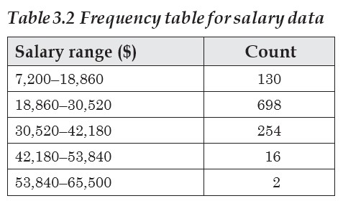
Example
Table 3.2 shows the salaries of graduates from a university.
Assume we do not have access to the original raw data and estimate the mean based only on the summary data.
Ch 3: Numerical Data Summary – Mean, Median, and Mode for Frequency Distributions

Slide 25
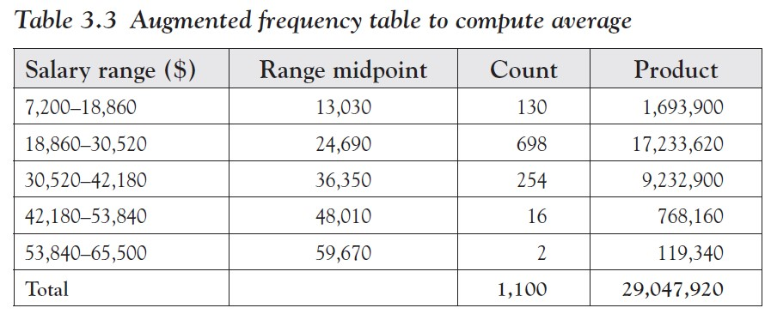
We will use Table 3.3 (hopefully together with Excel) to get organized.
To estimate the average – compute the range midpoints and product entries in Table 3.3
Then divide the sum of the products by the sum of the counts to get as average $29,047,920/1,100 = $26,407.20
Ch 3: Numerical Data Summary – Mean, Median, and Mode for Frequency Distributions
Notes:
There is no way to determine the actual average from this table, since we do not know how the numbers fit into the various intervals.
We would need access to the original raw data to find the true mean.
In a similar way you can compute the mean of an ordinal variable as long as you can assign some numerical value to the categories.

Slide 26
How do we find the median or the mode?
Compute the percentages for the frequency table:
The mode is the category with the largest percentage.
Add a column named “cumulative percentage” to the frequency table by computing the sum of all percentages of all categories below the current one:
The median is the first category where the cumulative percentage is above 50 percent.
Ch 3: Numerical Data Summary – Mean, Median, and Mode for Frequency Distributions

Slide 27
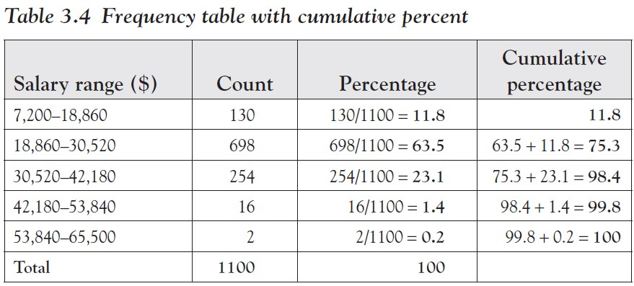
Example
Find the median and the mode for the salary (Table 3.2).
Add two columns to the table: one containing the frequency as percentage and the second containing the cumulative percentage (see Table 3.4).
We can see that the mode is the second category $18,860–$30,520 since it occurs most often with a relative frequency of 63.5 percent.
The median is also the second category, since it is the first where the cumulative percentage is above 50 percent.
Ch 3: Numerical Data Summary – Mean, Median, and Mode for Frequency Distributions
Notes:
Note that finding the median depends on the fact that the categories are ordered, of course, which means that the variable must be ordinal (or numerical in the case of a histogram).

Slide 28
While an average often helps in understanding the essence of data, it is not always helpful.
For example, if a quarterback throws the ball one foot too far half the time and one foot short the other half, then on average he has a perfect game yet he does not make a single completion.
Another example: suppose that school attendance in a particular school has risen from 80 to 95 percent over the past five years.
To evaluate next year’s attendance, we compare it to the average over the past five years, which is 87 percent.
Suppose attendance comes in at 90 percent.
We think we had an improvement in attendance as compared to the five-year average, yet in reality attendance dropped from the previous year.
Ch 3: Numerical Data Summary – Mean, Median, and Mode for Frequency Distributions

Slide 29
Example
Suppose two machines produce nails that are on average 10 in. long. A sample of 11 nails is selected from each machine and each length is recorded, as denoted in the following text.
Which machine is “better” (justify your choice)?
Machine A: 6, 8, 8, 10, 10, 10, 10, 10, 12, 12, 14
Machine B: 6, 6, 6, 8, 8, 10, 12, 12, 14, 14, 14
First we verify that the average length of the sample is 10:
Mean for machine A: $\overline{\text{x}}$ = $\frac{110}{11}$ = 10
Mean for machine B: $\overline{\text{x}}$ = $\frac{110}{11}$= 10
In both cases, the mean is 10, indeed.
However, the first machine seems to be the better one, since most nails are close to 10 in.
Therefore, we must find additional numbers indicating the spread of the data.
Ch 3: Numerical Data Summary – Measures of Dispersion – Range, Variance, and Standard Deviation

Slide 30
Range
The difference between the highest and the lowest data value
The easiest measure of the data spread
In the preceding example, the range is the same for both machines, namely, 14 - 6 = 8.
The range is, while useful, too crude a measure of dispersion.
As a case in point, both machines in the preceding example have the same range, so that figure cannot be used to differentiate between the two machines.
Ch 3: Numerical Data Summary – Measures of Dispersion – Range, Variance, and Standard Deviation

Slide 31
We now want to find out how much the data points are spread around the mean:
We could find the difference between each data point and the mean, and average these differences.
However, we want to measure these differences regardless of the sign (positive and negative differences should not cancel out).
Therefore, we could find the absolute value of the difference between each data point and the mean, average these differences.
But for theoretical reasons an absolute value function is not easy to deal with, so that one chooses a square function instead, which also neutralizes signs.
Finally, for yet other theoretical reasons we shall use not the sample size n to compute an average but instead n - 1.
Ch 3: Numerical Data Summary – Measures of Dispersion – Range, Variance, and Standard Deviation

Slide 32
Variance
Measures the spread of the data around the mean
Its definition depends on whether you want to find the population or sample variance.
There are two symbols for the variance, just as for the mean:
In virtually all applications we will use the second formula (the sample variance).
This is true in particular when we do not specify which of the two formulas to use: the default formula is the one for sample variance.
variance for a population
variance for a sample
Ch 3: Numerical Data Summary – Measures of Dispersion – Range, Variance, and Standard Deviation
Notes:
Hence, we will use the following formulas to compute the data spread, or variance.

Slide 33
Note that the two formulas are very similar:
population variance involves
the population mean μ
the population size N
and divides the sum by N
sample variance uses
the sample mean $\overline{x}$
the sample size $n$
and divides the sum by $n$ - 1
For some information about sample versus population variance, see https://en.wikipedia.org/wiki/Variance
Ch 3: Numerical Data Summary – Measures of Dispersion – Range, Variance, and Standard Deviation

Slide 34
How to Find the (Sample) Variance Manually
Make a table of all x values.
Find the mean of the data.
Add a column with the difference of each data point to the mean.
Add a column with the square of that difference.
Sum up the last column and divide the sum by (n - 1).
Ch 3: Numerical Data Summary – Measures of Dispersion – Range, Variance, and Standard Deviation

Slide 35
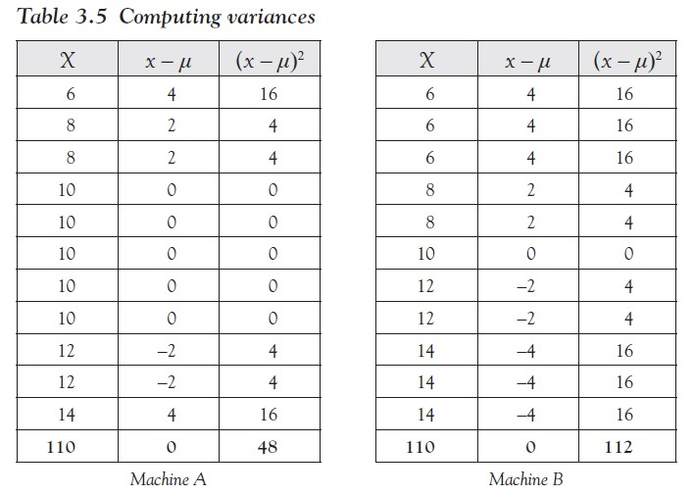
Table 3.5 shows the results of this procedure for the preceding sample of nails from machines A and B.
Note that the mean is the sum of column 1 divided by N = 11, which we need to compute first before we can determine column 2 or 3.
Ch 3: Numerical Data Summary – Measures of Dispersion – Range, Variance, and Standard Deviation

Slide 36
Thus we have the following:
The variance of machine A:
The variance of machine B:
Thus, the spread around the mean for machine A is 4.8 and that for machine B is 11.2.
This means that machine A, as a rule, produces nails that stick pretty close to the average nail length.
Machine B, on the other hand, produces nails with more variability than machine A.
Therefore, machine A would be preferred over machine B.
Ch 3: Numerical Data Summary – Measures of Dispersion – Range, Variance, and Standard Deviation
Notes:
Note: The unit of the variance is the square of the original unit, which is unfortunate; we would prefer the same unit as the original data. Therefore, one introduces an additional statistic, called the standard deviation, to fix this unit problem.

Slide 37
Standard Deviation
Measures the spread of the data around the mean, using the same unit as the data
The square root of the variance
As with the mean, there are two letters for variance and standard deviation:
$$σ= \sqrt{σ^{2}}$$
$$s= \sqrt{s^{2}}$$
population standard deviation
sample standard deviation
Ch 3: Numerical Data Summary – Measures of Dispersion – Range, Variance, and Standard Deviation

Slide 38
Example
Consider the sample data 6, 7, 5, 3, 4. Compute the standard deviation for that data.
To compute the standard deviation, we must first compute the mean, then the variance, and finally we can take the square root to obtain the standard deviation.
In this case we do not need to create a table since there are very few numbers.
The mean:
The variance:
Standard deviation:
Ch 3: Numerical Data Summary – Measures of Dispersion – Range, Variance, and Standard Deviation

Slide 39
Shortcut for Variance
At first this second formula looks much more complicated, but it is actually easier since it does not involve computing the mean first.
In other words, using the second formula we can compute the variance (and therefore the standard deviation) without first having to compute the mean.
Ch 3: Numerical Data Summary – Measures of Dispersion – Shortcut for Variance
Notes:
It is somewhat inconvenient that we first have to compute the mean before getting to the standard deviation.
In particular, if we compute the standard deviation of n data points and then for some reason add one more data point, we have to redo the entire calculation.
Fortunately there is a nice shortcut to compute the variance (and thus the standard deviation)

Slide 40
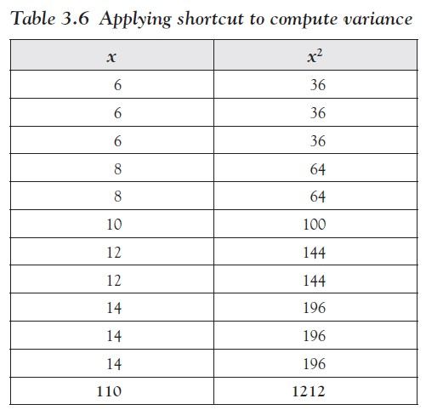
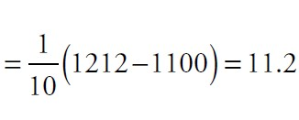
In our preceding example of machine B we would compute the variance using the shortcut as shown in Table 3.6.
Thus $\sum{x=110}$ and $\sum{x^{2 }=1212}$
so that the variance is
The same number as before, but a little easier to arrive at
Ch 3: Numerical Data Summary – Measures of Dispersion – Shortcut for Variance
Notes:
If you need to compute the variance manually, you should always use this shortcut formula.
For practice, compute the variance of machine A using this shortcut method.

Slide 41
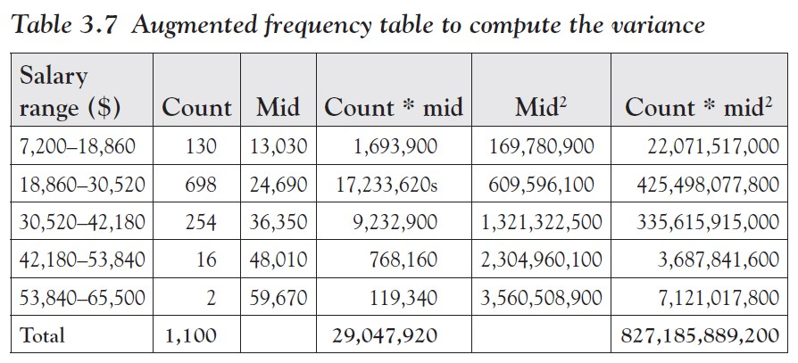
Example
Table 3.2 shows a frequency table of study of salaries of graduates from a university. Assuming the original data is unavailable, estimate the standard deviation.
Create Table 3.7 to get organized.
Ch 3: Numerical Data Summary – Variance and Standard Deviation for Frequency Tables

Slide 42
To estimate the variance we use the shortcut formula:
Thus, the variance is approximately 54,696,684.42 and therefore the standard deviation, which has the unit of “dollars,” is the square root of that number, or $7,395.72.
Ch 3: Numerical Data Summary – Variance and Standard Deviation for Frequency Tables
Notes:
The numbers in this example turned out to be huge, which made the process somewhat confusing.
For smaller numbers, everything seems slightly easier, hopefully.

Slide 43
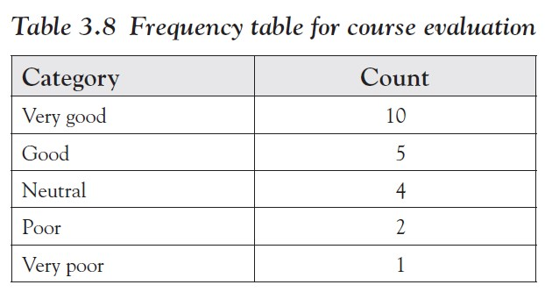
Example
The evaluation of a statistics lecture resulted in the frequency distribution shown in Table 3.8. Find the mean, median, variance, and standard deviation.
Ch 3: Numerical Data Summary – Variance and Standard Deviation for Frequency Tables

Slide 44
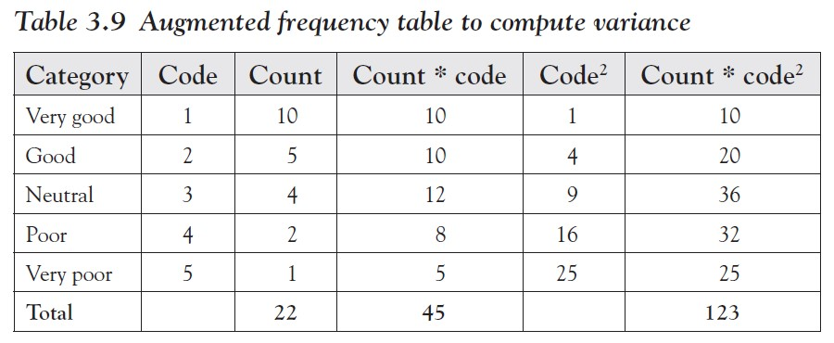
This is an ordinal variable so that we need to come up with (more or less arbitrary) numerical code values. With those codes chosen, we will expand the table as shown in the previous example.
Therefore, the mean is 2.04 and the standard deviation is 1.21 as you can confirm with a calculator.
In other words, the average category is “good” and the spread is relatively small, about one category.
Ch 3: Numerical Data Summary – Variance and Standard Deviation for Frequency Tables

Slide 45
Lower quartile $Q_{1}$
Upper quartile $Q_{3}$
That number such that 25 percent of observations are less than it and 75 percent are larger, or to be more precise, at least 25 percent of the sorted values are less than or equal to $Q_{1}$ and at least 75 percent of the values are greater than or equal to $Q_{1}$.
That number such that 75 percent of observations are less than it and 25 percent are larger, or to be more precise, at least 75 percent of the sorted values are less than or equal to $Q_{3}$, and at least 25 percent of the values are greater than or equal to $Q_{3}$.
Ch 3: Numerical Data Summary – Quartiles and Percentiles
Notes:
At this point we can describe the results of an experiment using two numbers (or parameters): a measure of central tendency (mean or median) and a measure of dispersion (the standard deviation, computed from the variance). That will tell us the “center” of the distribution of values (mean) and the “spread” around that center (standard deviation).

Slide 46
Following this notation, the median should actually be called the “middle quartile” $Q_{2}$, since it is that number such that 50 percent are less than it and 50 percent are larger
Traditionally, however, the term median is used.
Important: To find the quartiles, you must first sort your data (similar to finding the median).
Ch 3: Numerical Data Summary – Quartiles and Percentiles

Slide 47
Example
Compute the upper and lower quartiles of the numbers 2, 4, 6, 8, 10, 12, 14.
The numbers are already sorted, so that it is easy to see that the median is 8 (three numbers are less than 8 and three are bigger).
In other words, 8 splits our numbers up into the set of smaller numbers {2, 4, 6} and the set of larger ones {10, 12, 14}.
The quartiles, in turn, split up these sets in the middle again, so that ${\text{Q}}_{1}$ = 4 and ${\text{Q}}_{3}$ = 12.
Note that the numbers 2 and 4 are less than or equal to the lower quartile, while 4, 6, 8, 10, 12, 14 are larger than or equal to ${\text{Q}}_{1}$.
Therefore, 2 out of 7 or 28 percent of values are less than or equal to ${\text{Q}}_{1}$ and 6 out of 7 = 86 percent are larger than ${\text{Q}}_{1}$.
Ch 3: Numerical Data Summary – Quartiles and Percentiles

Slide 48
Example
Compute the upper and lower quartiles of the numbers 1, 2, 3, 4, 5.
Now the median is 3, leaving two sets {1, 2} and {4, 5}.
To split these numbers in the middle does not work, so it is not immediately clear what the quartiles are.
If ${\text{Q}}_{1}$ = 1, then one value out of five is less than or equal to ${\text{Q}}_{1}$, or 20 percent. According to our definition that is not enough, so ${\text{Q}}_{1}$ must be bigger than 1.
If ${\text{Q}}_{1}$ = 2, then two values out of five are less than or equal to ${\text{Q}}_{1}$, or 40 percent. Similarly, four values out of five, or 80 percent, are larger than or equal to ${\text{Q}}_{1}$ so that the lower quartile is indeed 2.
Similarly, the upper quartile can be shown to be 4.
.
Ch 3: Numerical Data Summary – Quartiles and Percentiles

Slide 49
Note that the preceding definition of quartiles does not necessarily produce a unique answer.
For example, for the data set {2, 4, 6, 8} any number between 2 (included) and 4 (excluded) would be a valid lower quartile, because for any such number one out of four data values are smaller, while three out of four values are larger.
Thus, we select a slightly different and constructive algorithm to define quartiles (uniquely).
Ch 3: Numerical Data Summary – Quartiles and Percentiles

Slide 50
Sort all observations in ascending order.
Compute the position $L_{1}$ = 0.25 * N, where N is the total number of observations.
If $L_{1}$ is a whole number, the lower quartile is midway between the $L_{1}$-th value and the next one.
If $L_{1}$ is not a whole number, change it by rounding up to the nearest integer.
The value at that position is the lower quartile.
Computing lower quartile
Ch 3: Numerical Data Summary – Quartiles and Percentiles

Slide 51
Sort all observations in ascending order.
Compute the position $L_{3}$ = 0.75 * N, where N is the total number of observations.
If $L_{3}$ is a whole number, the lower quartile is midway between the $L_{3}$-th value and the next one.
If $L_{3}$ is not a whole number, change it by rounding up to the nearest integer.
The value at that position is the lower quartile.
Computing upper quartile
Ch 3: Numerical Data Summary – Quartiles and Percentiles

Slide 52
Example
Find the quartiles for the values 2, 4, 6, 8, 10, 12, 14 and also for the values 2, 4, 6, 8 using this new method.
First we observe that the data set(s) are already sorted.
For the set 2, 4, 6, 8, 10, 12, 14 we have N = 7:
$L_{1}$ = 0.25 * 7 = 1.75, which gets rounded up to 2.
Thus, take the number in the second position to be the lower quartile so that $Q_{1}$ = 4.
$L_{3}$ = 0.75 * 7 = 5.25, which gets rounded up to 6.
Thus, take the sixth number to be the upper quartile so that $Q_{3}$ = 12.
Ch 3: Numerical Data Summary – Quartiles and Percentiles

Slide 53
For the set 2, 4, 6, 8 we have N = 4:
$L_{1}$ = 0.25 * 4 = 1, a whole number.
Thus, we again take the number between the first and second positions to be the lower quartile, that is, $Q_{1}$ = 3.
$L_{3}$ = 0.75 * 4 = 3
Thus, we take the number between the third and fourth values, that is, $Q_{3}$ = 7.
Ch 3: Numerical Data Summary – Quartiles and Percentiles
Notes:
Note that there are at least a dozen different ways to compute quartiles.
The preceding procedures are the preferred way in this text but depending on the software package used (such as SAS, JMP, MINITAB, or Excel), other numbers are possible.
We will revisit the quartiles to figure out what these numbers can tell us about the distribution of our data. Before we do that, though, we will expand the idea of quartiles to “percentiles.”
Quartiles are useful and they help to describe the distribution of values as we will see later.
However, we often want to know how one particular data value compares to the rest of the data.
For example, when taking standardized test scores such as SAT scores, I want to know not only my own score, but also how my score ranks in relation to all scores.
Percentiles are perfect for this situation.

Slide 54
k-th percentile
That number such that k percent of all data values are less and (100 - k) percent are larger than it
More precisely, at least k percent of the sorted values are less than or equal to it and at least (100 - k) percent of the values are greater than or equal to it.
Note: The lower quartile is the same as the 25th percentile, the median is the same as the 50th percentile, and the upper quartile is the same as the 75th percentile.
Ch 3: Numerical Data Summary – Quartiles and Percentiles

Slide 55
Example
A student took the SAT test. Her score in the math portion of the test puts her in the 95th percentile. Did she do well or poorly on the test?
If a score is ranked as the 95th percentile, then by definition 95 percent of all scores are less than the given score, while only 5 percent of students scored higher.
That would be a pretty good result with only 5 percent of students who scored higher than that student.
In other words, our student would be in the top 5 percent.
Ch 3: Numerical Data Summary – Quartiles and Percentiles

Slide 56
To find
the k-th
percentile:
Sort all observations in ascending order.
Compute the position L = (k/100) * N, where N is the total number of observations.
If L is a whole number, the k-th percentile is the value midway between the L-th value and the next one.
If L is not a whole number, change it by rounding up to the nearest integer. The value at that position is the k-th percentile.
Ch 3: Numerical Data Summary – Quartiles and Percentiles

Slide 57
Example
Consider the following cotinine levels of 40 smokers:
Find the quartiles and the 40th percentile.
Ch 3: Numerical Data Summary – Quartiles and Percentiles

Slide 58
First note that before we start our computations we must sort the data—computing percentiles for non sorted data is the most common mistake.
Here is the same data again, this time sorted:
Ch 3: Numerical Data Summary – Quartiles and Percentiles

Slide 59
Now we can do our calculations, with N = 40 (number of values in our data set):
Lower quartile: 0.25 * 40 = 10, so we need to take the value midway between the 10th value, which is 86, and the 11th value, which is 87.
Hence, the lower quartile is 86.5.
Upper quartile: 0.75 * 40 = 30, so we need to take the value midway between the 30th value, which is 250, and the 31st value, which is 253.
Hence, the upper quartile is (250 + 253)/2 = 251.5.
40th percentile: 0.4 * 40 = 16, so the 40th percentile is (130 + 131)/2 = 130.5.
Ch 3: Numerical Data Summary – Quartiles and Percentiles
Notes:
However, for percentiles another question is usually asked: given a particular value, find that percentile that corresponds to this value.
In other words, determine how many values are lesser and how many values are larger than the particular value.

Slide 60
percentile value of a number x
Percentile value of x = (number of values less than x)/(total number of values) * 100
Example
Suppose you took part in the preceding study of cotinine levels and your personal cotinine level was 245. What is the percentile value of 245, and how many people in the study had a higher cotinine level than you?
Ch 3: Numerical Data Summary – Box Plot and Distributions

Slide 61
First note that in our sorted data the value 245 is in the 29th position.
Therefore, according to our formula:
Thus, by definition of percentiles, 72.5 percent of values are less than 245 while (100 - 72.5) = 27.5 percent are larger than 245.
Percentile value of 245 = 29/40 * 100 = 72.5
Ch 3: Numerical Data Summary – Quartiles and Percentiles

Slide 62
Box plot
Sometimes also called “box and whiskers plot”
Combines the minimum and maximum values (and therefore the range) with the quartiles and the median into one useful graph
Consists of a horizontal line, drawn according to scale from the minimum to the maximum data value, and a box drawn from the lower to upper quartile with a vertical line marking the median
Ch 3: Numerical Data Summary – Box Plot and Distributions

Slide 63
Example
In an earlier example we considered the following cotinine
levels of 40 smokers. Draw a box plot for that data.
Ch 3: Numerical Data Summary – Box Plot and Distributions

Slide 64
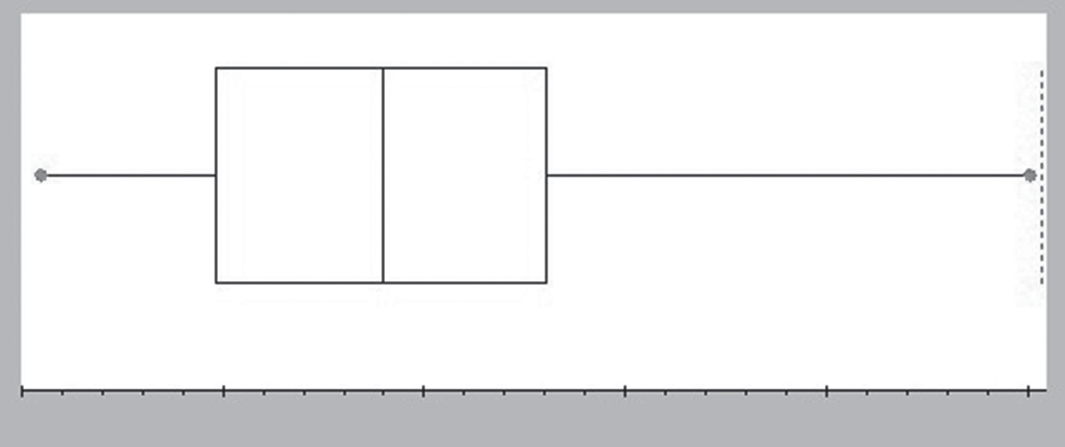
We already computed the lower and upper quartiles to be $Q_{1}$ = 86.5 and $Q_{3}$ = 251.5, respectively.
It is easy to see that the minimum is 0 and the maximum is 491.
A quick computation shows that the median is 170.
You can see that the horizontal line (sometimes called the “whiskers”) goes from 0 to 491 (minimum to maximum), while the inside box extends from 86.5 (= $Q_{1}$) to 251.5 (= $Q_{3}$) with a middle vertical line at 170 (the median).
Figure 3.2 Box plot
For some data sets you will see some points beyond the line indicating the whisker.
Those points are outliers – exceptionally small or large compared to the rest of the data.
Ch 3: Numerical Data Summary – Box Plot and Distributions

Slide 65
Inter quartile range (IQR)
Defined as the difference between the upper and lower quartiles
Used, among other things, to define outliers
Example
Find the IQR for the life expectancy data in 2014:
www.betterbusinessdecisions.org/data/life.xlsx
Ch 3: Numerical Data Summary – Box Plot and Distributions

Slide 66
The life expectancy data lists average life expectancy and literacy rates in 223 countries of the world in 2014.
We sort the data from the smallest to the largest and compute the quartiles and the medium:
$Q_{1 }$: position = 223 * 0.25 = 55.75, $Q_{1 }$ = 66.85 (for Papua New Guinea)
$Q_{3 }$: position = 223 * 0.75 = 167.25, $Q_{3 }$ = 78.3 (for Panama)
Median: position = 223 * 0.5 = 111.5, median = 74.33 (for Bulgaria)
Thus, the “lower hinge” of the box is $Q_{1 }$ = 66.85 and the upper hinge is $Q_{3 }$ = 78.3.
By definition, that makes the IQR = 78.3 - 66.85 = 11.45.
Ch 3: Numerical Data Summary – Box Plot and Distributions

Slide 67
In addition to giving you a quick view of the range, the quartiles, the median, and the IQR, the box plot also indicates the shape of the histogram for this data, that is, its distribution:
The histogram would look slightly skewed to the left if the box in the box plot is shifted somewhat toward the right.
The histogram would look slightly skewed to the right if the box in the box plot is shifted toward the left.
Ch 3: Numerical Data Summary – Box Plot and Distributions
Notes:
In fact, even though the box plot does not directly contain the mean (it only shows the median) it is possible to estimate whether the mean is less than or greater than the median by looking whether the box plot is skewed to the left or to the right.

Slide 68
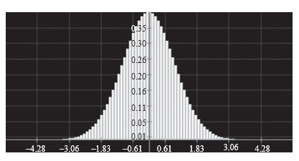
Bell-shaped or normal histogram (distribution)
Figure 3.3 A normal distribution
Looks similar to a symmetric “bell curve”
Most data points fall in the middle
There are few exceptionally small and few exceptionally large values.
Ch 3: Numerical Data Summary – Box Plot and Distributions

Slide 69
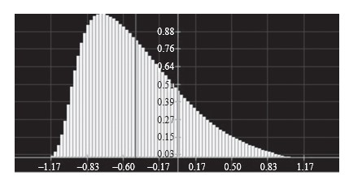
Skewed to the right histogram (distribution)
Figure 3.4 A distribution skewed to the right
Looks like a bell curve with a longer tail on the right and the mount pushed somewhat to the left
Most data points fall to the left of the middle
There are more smaller than larger values, but there are a few extreme values on the right.
Ch 3: Numerical Data Summary – Box Plot and Distributions

Slide 70
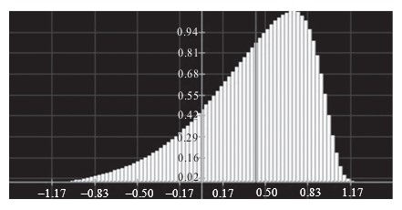
Skewed to the left histogram (distribution)
Figure 3.5 A distribution skewed to the left
Looks like a bell curve with a longer tail on the left and the mount pushed somewhat to the right
Most data points fall to the right of the middle
There are more larger than smaller values, but there are a few extreme values on the left.
Ch 3: Numerical Data Summary – Box Plot and Distributions

Slide 71
If the distribution is normal, there are few exceptionally large or small values.
The mean will be about the same as the median and the box plot will look symmetric.
If the distribution is skewed to the right most values are “small,” but there are a few exceptionally large ones.
Those large exceptional values will impact the mean and pull it to the right, so that the mean will be greater than the median.
The box plot will look as if the box was shifted to the left so that the right tail will be longer.
The median will be closer to the left line of the box in the box plot.
Ch 3: Numerical Data Summary – Box Plot and Distributions
Notes:
You can tell the shape of the histogram (distribution)—in many cases at least—just by looking at the box plot, and you can also estimate whether the mean is less than or greater than the median.
Recall that the mean is impacted by especially large or small values, even if there are just a few of them, while the median is more stable with respect to exceptional values.

Slide 72
If the distribution is skewed to the left, most values are “large,” but there are a few exceptionally small ones.
The exceptional values will impact the mean and pull it to the left, so that the mean will be less than the median.
The box plot will look as if the box was shifted to the right so that the left tail will be longer.
The median will be closer to the right line of the box in the box plot.
Ch 3: Numerical Data Summary – Box Plot and Distributions

Slide 73
As a quick way to remember skewedness and its implications:
Longer tail on the left
skewed to the left
mean on the left of median (smaller)
Longer tail on the right
skewed to the right
mean on the right of median (larger)
Tails equally long
normal
mean about equal to median
Ch 3: Numerical Data Summary – Box Plot and Distributions

Slide 74
Example
Consider the (fictitious) data in an Excel sheet for three
variables named varA, varB, and varC:
www.betterbusinessdecisions.org/data/distribution-data.xls
Create a box plot for the data from each variable and decide, based on that box plot, whether the distribution of values is normal, skewed to the left, or skewed to the right, and estimate the value of the mean in relation to the median.
Then compute the values and compare them with your conjecture.
Ch 3: Numerical Data Summary – Box Plot and Distributions

Slide 75
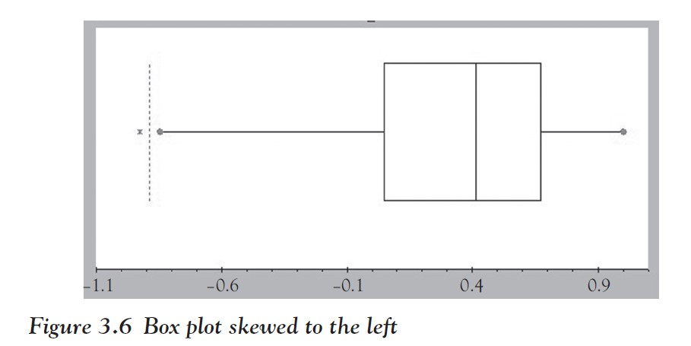
One of the data columns results in the box plot shown in Figure 3.6 (note that there is one outlier on the left).
The distribution is shifted to the left, and the mean should be less than the median (the exact numbers are: mean = 0.3319, median = 0.4124).
Ch 3: Numerical Data Summary – Box Plot and Distributions
Notes:
Note that Excel does not include a facility to produce a box plot automatically, but we will introduce a convenient alternative later.
For your convenience, we have created the corresponding box plots in Figures 3.6 to 3.8.

Slide 76
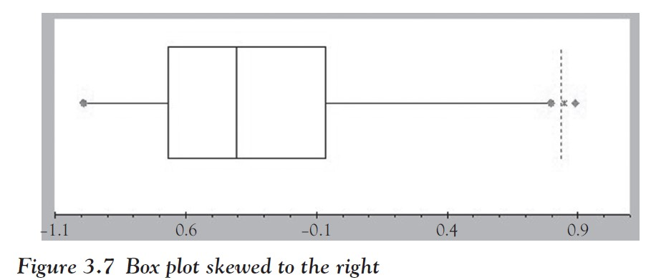
The other data column has the box plot shown in Figure 3.7 (it has two outliers on the right).
The distribution is shifted to the right, and the mean should be greater than the median (the exact numbers are: mean = -0.3192, median = -0.4061).
Ch 3: Numerical Data Summary – Box Plot and Distributions

Slide 77
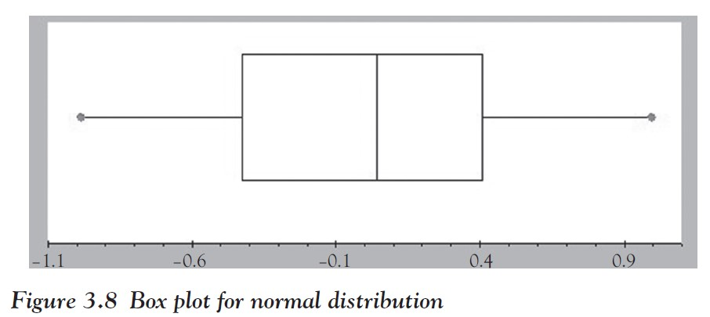
The final data column has the box plot shown in Figure 3.8.
The distribution is (approximately) normal, and the mean and median should be similar (the exact numbers are: mean = 0.013 median = 0.041).
Ch 3: Numerical Data Summary – Box Plot and Distributions
Notes:
Unfortunately, we forgot to write down which of these cases correspond to varA, varB, and varC—can you figure it out?

Slide 78
Outliers and Standard Deviation
We have seen that even though the box plot does not explicitly include the mean, it is possible to get an approximate idea about it by comparing it against the median and the skewness of the box plot:
If the distribution is skewed to the left, the mean is less than the median.
If the distribution is skewed to the right, the mean is bigger than the median.
In a somewhat similar fashion you can estimate the standard deviation based on the box plot.
Ch 3: Numerical Data Summary – Outliers and Standard Deviation

Slide 79
The relation between range, IQR, and standard deviation
The standard deviation is approximately equal to range/4.
The standard deviation is approximately equal to 3/4 * IQR.
Both estimates work best for normal distribution, that is, distributions that are not skewed, and the first approximation works best if there are no outliers.
Ch 3: Numerical Data Summary – Outliers and Standard Deviation

Slide 80
Outliers
Data points that fall below $Q_{1}$ - 1.5 * IQR or above $Q_{3}$ + 1.5 * IQR.
Example
Consider the preceding data on cotinine levels of 40 smokers.
Find the IQR and use it to estimate the standard deviation.
Also identify any outliers.
Ch 3: Numerical Data Summary – Outliers and Standard Deviation

Slide 81
The data ranges from 0 to 491 (from minimum to maximum), while $Q_{1}$ = 86.5 and $Q_{3}$ = 251.
Thus, we have two estimates for the standard deviation:
s is approximately equal to range/4 = 491/4 = 122.75
s is approximately equal to 3/4 * IQR = 0.75 * (251 - 86.5) = 123.375
The estimates are pretty close to each other and since the true standard deviation is 119.5, they are both pretty close to the actual value.
The best part of these estimates is, however, that they are very simple to compute and thus they give you a quick ballpark estimate for the standard deviation.
Ch 3: Numerical Data Summary – Outliers and Standard Deviation

Slide 82
As for any outliers, they would be data values:
Above $Q_{3}$ + 1.5 * IQR = 251 + 1.5 * 164.5 = 497.75: none
Below $Q_{1}$ - 1.5 * IQR = 86.5 - 1.5 * 164.5 = -160.1: none
So there are no outliers in this case (which is one reason why the estimate of range/4 works so well).
Ch 3: Numerical Data Summary – Outliers and Standard Deviation

Slide 83
Example
Find all outliers for the life expectancy data we looked at before:
www.betterbusinessdecisions.org/data/life.xlsx
For that data set we found that IQR = 78.3 - 66.85 = 11.45 and therefore the outliers would be data values:
Above $Q_{3}$ + 1.5 * IQR = 78.3 + 1.5 * 11.45 = 95.475
Below $Q_{1}$ - 1.5 * IQR = 66.85 - 1.5 * 11.45 = 49.675
Thus, two data points for South Africa (49.56) and Chad (49.44) are outliers below, while there are no outliers above.
Note that since there are outliers, the range/4 estimate for the standard deviation should not work as well as the estimate based on the IQR. Confirm that!
Ch 3: Numerical Data Summary – Outliers and Standard Deviation

Slide 84
Excel simple functions for computing measures of central tendency:
= average(RANGE) | Computes the average (mean) of the numbers contained in the RANGE. Ignores cells containing no numerical data, that is, cells that contain text or no data do not contribute anything to the computation of the mean.
= count(RANGE) | Computes the amount of numbers contained in the RANGE.
= mode(RANGE) | Computes the mode of the numbers contained in the RANGE. If the cell range consists of several numbers with the same frequency, the function returns only the first (smallest) number as the mode. If all values occur exactly once, the Excel mode function returns N/A for “not applicable.”
= median(RANGE) | Computes the median of the numbers contained in the RANGE. Ignores cells containing no numerical data.
= sum(RANGE) | Computes the sum of the numbers contained in the RANGE.
= skew(RANGE) | Returns the skewness: if negative, data is left skewed. If positive, data is right skewed.
Ch 3: Numerical Data Summary – Descriptive Statistics Using Excel

Slide 85
Exercise
Find the mean, mode, and median of the salary of MLB
players.
Why are they so different?
Which one best represents the measure of central tendency?
Did we compute the population mean (or median) or the sample mean (or median)?
www.betterbusinessdecisions.org/data/MLBPlayerSalaries.xlsx
Ch 3: Numerical Data Summary – Descriptive Statistics Using Excel
Notes:
Let us use our new formulas on an interesting data set: the salaries of Major League Baseball (MLB) players from 1988 to 2011.

Slide 86
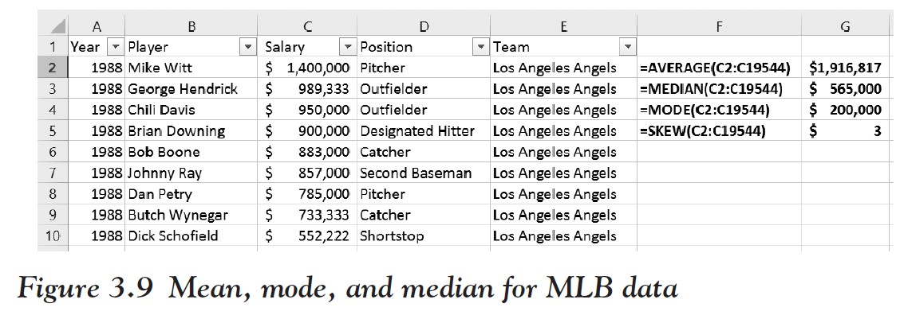
Figure 3.9 shows the formulas that were used together with the resulting values.
Ch 3: Numerical Data Summary – Descriptive Statistics Using Excel

Slide 87
The mean is $1,916,817, which is indeed very different from the median of $565,000.
To explain the difference, we also computed the skewness factor, which is 3.0.
That means that the distribution is (heavily) skewed to the right, that is, there are a few exceptionally large values that will pull the mean up above the median.
Indeed, there are a few superstar baseball players who impact the mean but not the median.
Leading the pack is Alex Rodriguez from the New York Yankees with $33,000,000 per year in 2009 and 2010 and a combined salary of over $284,000,000 between 2001 and 2011.
Most players do not come close to this figure; in fact, 50 percent of players make less than the relatively modest $565,000, since that is the median.
Ch 3: Numerical Data Summary – Descriptive Statistics Using Excel

Slide 88
For the fun of it, we used the pivot tool to compute the average salary per ball club for the combined years (see Figure 3.10).
As most of you probably suspected, the team with the highest average salary (by far) is the New York Yankees, followed by the Boston Red Sox and the New York Mets. Bringing up the rear are the Washington Nationals and the Pittsburgh Pirates.
Figure 3.10 Average salaries per ball club in MLB
Ch 3: Numerical Data Summary – Descriptive Statistics Using Excel

Slide 89
In addition to measures of central tendency, Excel also provides formulas to compute range, variance, and standard deviation:
=max(RANGE) - min(RANGE) | Computes the range as the maximum minus the minimum value.
=var(RANGE) | Computes the variance (ignores cells containing no numerical data).
=var.p(RANGE) | New function to compute the population variance.
=var.s(RANGE) | New function to compute the sample variance.
=stdev(RANGE) | Computes the standard deviation (ignores cells containing no numerical data).
=stdev.p(RANGE) | New function to compute the population standard deviation.
=stdev.s(RANGE) | New function to compute the sample standard deviation.
Ch 3: Numerical Data Summary – Descriptive Statistics Using Excel

Slide 90
Example
Use the preceding formulas to compute the mean, range,
variance, and standard deviation of the salaries of graduates for the University of Florida:
www.betterbusinessdecisions.org/data/u-floridagraduationsalaries.xls
Ch 3: Numerical Data Summary – Descriptive Statistics Using Excel

Slide 91
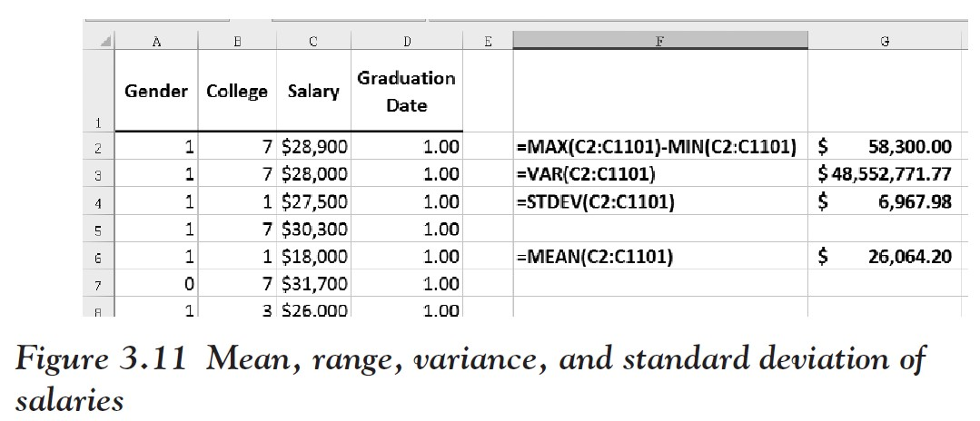
All that is involved here is adding the appropriate formulas to the Excel worksheet (see Figure 3.11).
Note: The variance is displayed as dollars, even though that is not correct (it should be “square dollars,” which does not make much sense). The standard deviation, on the other hand, has indeed dollars as unit.
Ch 3: Numerical Data Summary – Descriptive Statistics Using Excel
Notes:
There are a number of additional statistical functions that can be used as needed but Excel also provides a convenient tool to compute many of the most commonly used descriptive statistics such as mean, mode, median, variance, standard deviation, and more all at once and for multiple variables simultaneously.

Slide 92
Example
The following Excel spreadsheet contains some data about life expectancy and literacy rates in over 200 countries of the world in 2014.
Compute the mean, mode, median, variance, standard deviation, and range of the two variables:
www.betterbusinessdecisions.org/data/life_literate.xlsx
Ch 3: Numerical Data Summary – Descriptive Statistics Using Excel

Slide 93
Load the data set as usual.
Then switch to the Data ribbon and pick the Data Analysis tool from our ToolPak on the far right.
Select the Descriptive Statistics tool.
Define as range the second and third columns titled “Life Expectancy” and “Literacy Rate” from B1 to C206, check the box “Label in First Row,” and check the option “Summary Statistics.”
Then click OK.
Ch 3: Numerical Data Summary – Descriptive Statistics Using Excel

Slide 94
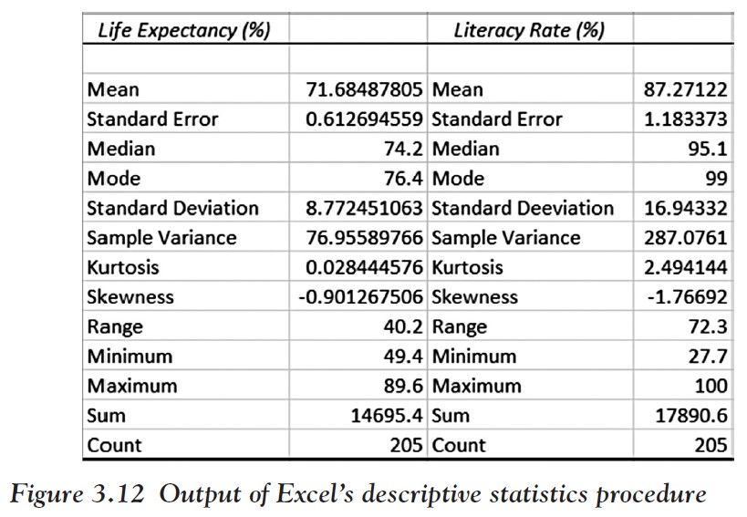
Excel will compute a variety of descriptive statistics all at once and for all (numerical) variables in the selected range; Figure 3.12 shows the output.
We can see, for example, that for the average “Life Expectancy” we have computed the mean to be 71.68, the median to be 74.2, and the mode to be 76.4.
The standard deviation is 8.77, the variance is 76.96, and the range is 40.2.
Both variables have a distribution that is skewed to the left and hence the mean will be smaller than the median.
Note that variance and standard deviation refer to the sample variance and standard deviation formulas.
Ch 3: Numerical Data Summary – Descriptive Statistics Using Excel

Slide 95
Excel can be used to find percentiles, and therefore upper and lower quartiles (which are just the 25th and 75th percentiles, respectively):
=quartile (RANGE, N) | Computes the lower quartile if N = 1, the median if N = 2, or the upper quartile if N = 3. Note that Excel uses a slightly different method to compute the quartiles from that described in the “Quartiles and Percentiles” section.
=percentile (RANGE, P) | Computes percentiles, where RANGE is a range of cells and P is the percentile to compute as a decimal number between 0 and 1. The data does not have to be sorted.
=percentrank (RANGE, X) | Computes the rank of a value x in a RANGE as a percentage of the data set (in other words, the percentile value of x). The data does not have to be sorted.
Ch 3: Numerical Data Summary – Using Excel to Find Percentiles

Slide 96
Note: the QUARTILE function used in Excel uses a definition that is slightly different from our (second) one earlier.
Thus, you cannot use Excel to check your own manual answers in many cases.
In fact, the calculation of the quartiles is different depending on the text or computer/ calculator package being used (such as SAS, JMP, MINITAB, Excel, and TI-83 Plus)
It turns out that Excel alone offers two functions to compute quartiles: QUARTILE.EXC and QUARTILE.INC (which is the same as our familiar QUARTILE function).
Check the article at www.amstat.org/publications/jse/v14n3/langford.html for more details.
Ch 3: Numerical Data Summary – Using Excel to Find Percentiles

Slide 97
Example
Load the Excel spreadsheet that contains the data about life expectancy and literacy rates in 205 countries of the world in 2014.
Find the upper and lower quartiles for both variables.
What is the percentile value for life expectancy in Japan, the United States, and in Afghanistan?
www.betterbusinessdecisions.org/data/life_literate.xlsx
Ch 3: Numerical Data Summary – Using Excel to Find Percentiles

Slide 98
We can use either the percentile or the quartile function to find the percentiles, or manually compute them.
For the variable “Life Expectancy”:
=percentile(B2:B206, 0.25) or =quartile (B2:B206,1) gives 67.1 as $Q_{1}$
=percentile(B2:B206, 0.75) or =quartile (B2:B206,3) gives 78.0 as $Q_{3}$
=0.25 * N = 51.25, so we pick the number at position 52, which is 67.1
=0.75 * N = 153.75, so we pick the number at position 154, which is 78.0
For the variable “People who Read”:
=percentile(C2:C206, 0.25) or =quartile (B2:B206,1) gives 81.4 as $Q_{1}$
=percentile(C2:C206, 0.75) or =quartile (B2:B206,1) gives 98.9 as $Q_{3}$
Ch 3: Numerical Data Summary – Using Excel to Find Percentiles

Slide 99
To find the relative ranking (aka percentiles) for Japan, the United States, and Afghanistan we use the “percentrank(range, x)” function where we substitute the life expectancy of the respective countries for x:
=percentrank(B2:B206, 50.5) = 0.014
Afghanistan is at the 1.4th percentile in life expectancy, that is, about 1.4 percent of countries have shorter and 98.6 percent have longer life expectancy than Afghanistan.
=percentrank(B2:B206, 84.5) = 0.99
Japan is at the 99th percentile in life expectancy, that is, about 99 percent of countries have shorter and 1 percent has longer life expectancy than Japan.
=percentrank(B2:B206, 79.6) = 0.828
The United States is at the 82.8th percentile in life expectancy, that is, about 82.8 percent of countries have shorter and 17.2 percent have longer life expectancy than the United States.
Ch 3: Numerical Data Summary – Using Excel to Find Percentiles

Slide 100
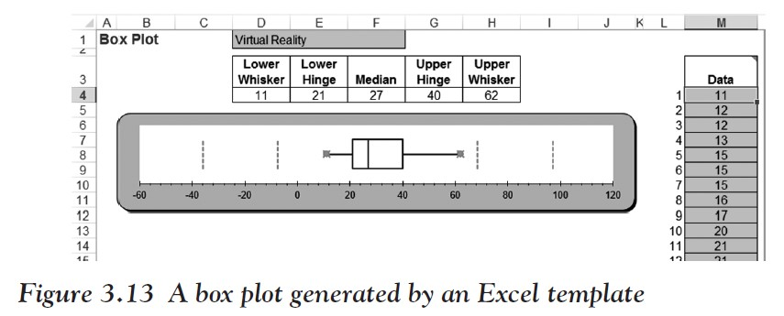
Drawing a Box Plot with Excel
To use the Excel box plot template, click on the following link to download the file:
www.betterbusinessdecisions.org/data/boxplot.xls
When you open the file, Excel will show you a worksheet with a finished box plot already, and a column on the right in green where you can enter or paste your data.
Simply delete the data currently in column M and replace it with your new data to create a new plot. The box plot will update automatically.
Ch 3: Numerical Data Summary – Drawing a Box Plot with Excel
Notes:
Unfortunately Excel does not have a nice built-in facility to quickly create a box plot. You could of course use the formulas introduced earlier to compute the values needed and then draw a box plot manually. However, there is an easy-to-use Excel template that is not quite as convenient as the data analysis tools we have been using, but it is still pretty simple and useful.

Slide 101
Example
Create a box plot for the life expectancy data by country that we considered before:
www.betterbusinessdecisions.org/data/life.xls
Ch 3: Numerical Data Summary – Drawing a Box Plot with Excel

Slide 102
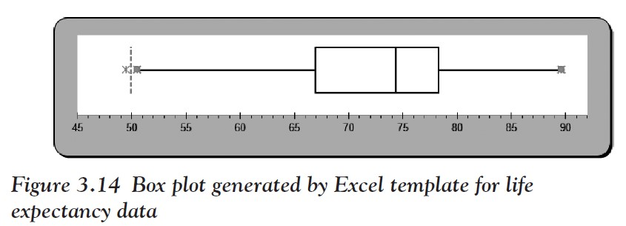
When the spreadsheet opens up, mark all numerical data in column B (the life expectancy column) but not including the column header and copy it to the clipboard (e.g., press CTRL-c).
Then open the boxplot.xls spreadsheet and position your cursor to the first data value in column M.
Paste the copied data values (e.g., press CTRL-v) into that column and the box plot will automatically update itself as shown in Figure 3.14.
Ch 3: Numerical Data Summary – Drawing a Box Plot with Excel

Slide 103
If your picture looks slightly different, you can double-click the horizontal axis to adjust the scale (minimum and maximum) so that the picture looks like that in Figure 3.14.
We can see one outlier value on the left (check if there really are extreme values according to our definition) and it seems that the distribution is skewed to the left.
Thus, we would expect the mean to be less than the median (verify that).
Ch 3: Numerical Data Summary – Drawing a Box Plot with Excel

Slide 104
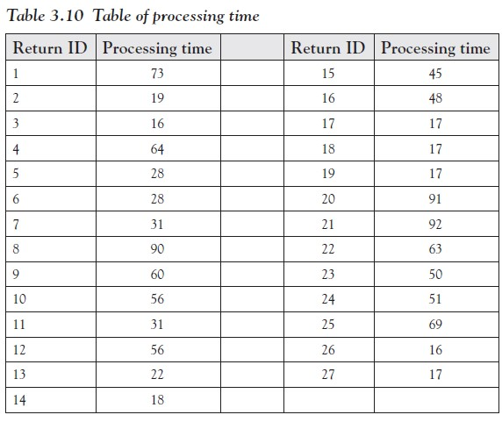
Excel Demonstration
Company S would like to better describe the processing times of tax returns for small businesses to future clients. To do so, Company S collected the processing time in days for the last 27 tax returns (see Table 3.10).
What would we tell a potential client about the expected processing times for tax returns?
Ch 3: Numerical Data Summary – Excel Demonstration

Slide 105
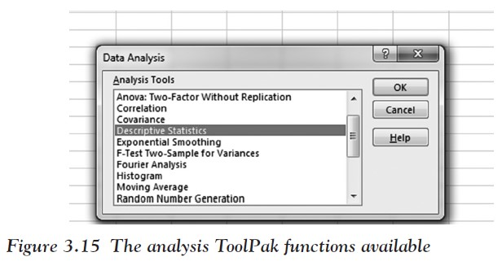
Step 1
Step 2
Enter the data in two columns, labeled “Return ID” and “Processing Time” into Excel.
Let us describe the data by finding out the mean, median, first quartile, third quartile, range, interquartile range, and standard deviation.
We can find many of these using the Analysis Tool- Pak “descriptive statistics” function, or we can use Excel formulas.
In the Analysis ToolPak, click on Descriptive Statistics as shown in Figure 3.15.
Ch 3: Numerical Data Summary – Excel Demonstration

Slide 106
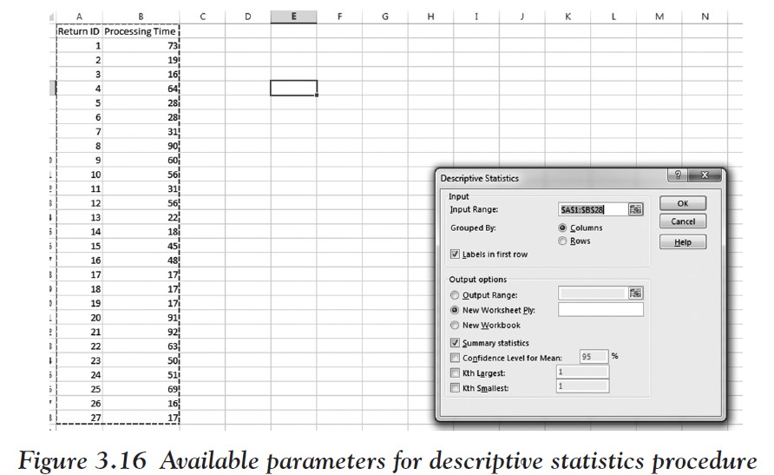
For the input range select the data, check Labels in first row since we included the labels
Click Summary statistics as shown in Figure 3.16
Click OK.
Ch 3: Numerical Data Summary – Excel Demonstration

Slide 107
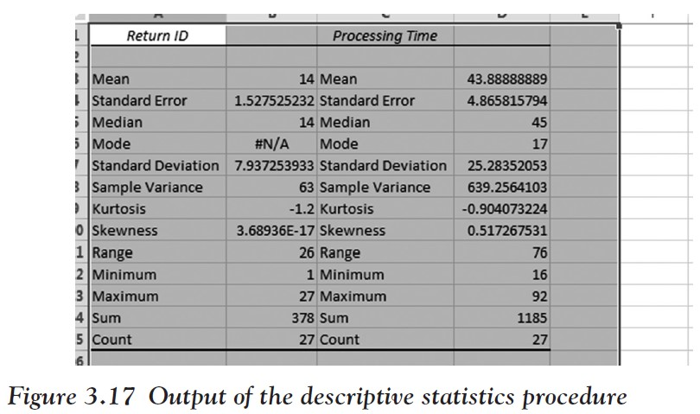
We are provided with the descriptive statistics for processing time and return ID.
Note we will not need data for Return ID for our analysis.
Figure 3.17 shows the output of the procedure.
Ch 3: Numerical Data Summary – Excel Demonstration

Slide 108
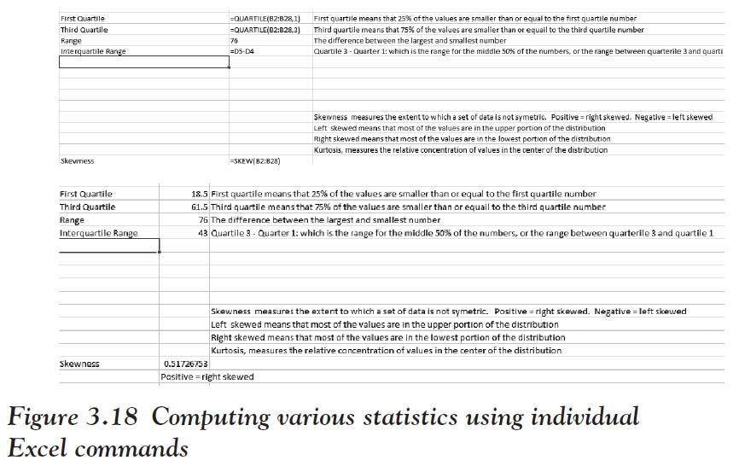
From this table we can now see the average processing time, median processing time, range, and standard deviation.
We can find the remaining required statistics using the formulas shown in Figure 3.18.
Ch 3: Numerical Data Summary – Excel Demonstration

Slide 109
In conclusion:
We can tell our potential client that the average processing time is around 44 days.
Based on the positively right skewed statistic, we expect most of the processing times to fall toward the lower portion of the distribution, so that there is hope that the actual processing time might be shorter.
Ch 3: Numerical Data Summary – Excel Demonstration

