Slide 1
Using Statistics for Better Business Decisions
Justin Bateh and Bert G. Wachsmuth
Copyright © Justin Bateh and Bert G. Wachsmuth, 2016. All rights reserved.

Slide 2
Chapter 2 Data Visualization
Using Statistics for Better Business Decisions
Copyright © Justin Bateh and Bert G. Wachsmuth, 2016. All rights reserved.

Slide 3
Learning Objectives
Organize data
Construct tables and charts for numerical data
Construct tables and charts for categorical data
Describe the principles of properly presenting graphs
Use Microsoft Excel to present data in basic graphs and charts
Demonstrate how to create a pivot table and histogram
Ch 2: Data Visualization– Learning Objectives

Slide 4
Pie Charts
convenient way to visualize data if the categories that divide the data are not that numerous (eight or less)
apply to categorical variables (either ordinal or nominal)
in most cases they are not appropriate for numerical variables
divides a circle into segments such that the area of each segment over the total area corresponds to the ratio of each number over the total
Ch 2: Data Visualization – Pie Charts and Bar Charts
Notes:
Introduction
In this chapter we will discuss a variety of ways to visualize data and how to use Excel to accomplish the visualization.
We will also show how charts can be used to emphasize different points of views without modifying or falsifying data.

Slide 5
Example:
Suppose a survey was conducted among 1,000 adults about their job status, with the following results:
Use a pie chart to represent this data.
No job | One job | More than one job
122 | 536 | 342
Ch 2: Data Visualization – Pie Charts and Bar Charts

Slide 6
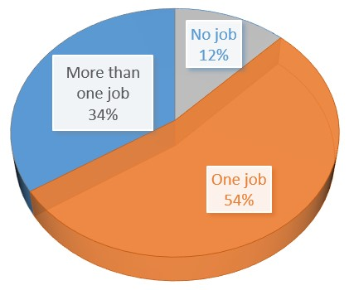
Mechanics of creating charts with Excel:
Note that Excel has automatically converted the raw data into percentages of the total and rounded it properly.
In other words the figure for “one job” was converted to
If you move your cursor over the various slices of the pie while inside Microsoft Excel, you will see the total number as well as the number in percentage corresponding to that slice.
Figure 2.1 Sample pie chart with three segments
536/(122 + 536 + 342) * 100 = 536/1000 * 100
= 53.6 percent, rounded up to 54 percent
Ch 2: Data Visualization – Pie Charts and Bar Charts

Slide 7
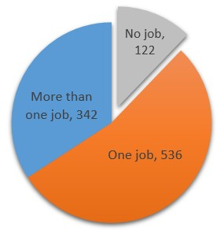
Exploding your pie chart:
Figure 2.2 A so-called exploding pie chart
Simply click on one of the pie slices (not any text, though) and drag it outwards a little—your chart will explode!
You can either make one slice move out of the pie or all slices.
useful to highlight one particular slice
In Figure 2.2 we have also colored that slice light gray to further accentuate it.
Ch 2: Data Visualization – Pie Charts and Bar Charts
Notes:
Bar charts are applicable to categorical variables, just as pie charts, but they can accommodate more categories.

Slide 8
Example:
A survey was conducted to find the number of workers employed by major foreign investors.
The results are presented in this table.
Construct a bar chart representing this data.
Great Britain | Germany | Japan | Netherlands | Ireland
6,500 | 1,450 | 1,200 | 200 | 138
Ch 2: Data Visualization – Pie Charts and Bar Charts

Slide 9
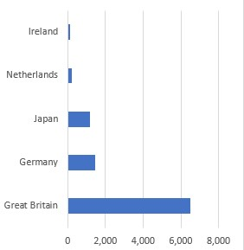
Bar chart
Figure 2.3 A sample bar chart
Uses vertical or horizontal bars whose length corresponds to the frequency of each category
In our example, the bars represent the number of workers employed by major foreign investors.
Ch 2: Data Visualization – Pie Charts and Bar Charts
Notes:
The first attempt is shown in Figure 2.3.

Slide 10
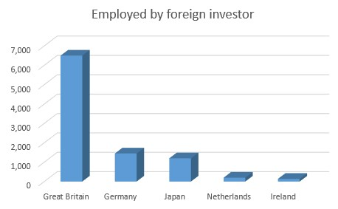
Figure 2.4 A bar chart with vertical bars and a title
Ch 2: Data Visualization – Pie Charts and Bar Charts
Notes:
Nice, but we do not like that the bars go horizontally; it would be nicer if they went vertically.
We use some of the options Excel provides to change the bar chart to the one shown in Figure 2.4.

Slide 11
To summarize:
Pie charts and bar charts can be used to visualize the number of values in each category for a categorical variable.
They represent a visual representation of the frequencies of the various categories and are useful to quickly find data that either has a particularly high or low frequency as compared to other data values.
A pie chart becomes difficult to read if there are more than 6 or 7 categories, while a bar chart can handle up to 20 categories or more.
Ch 2: Data Visualization – Pie Charts and Bar Charts

Slide 12
Frequency Histograms (or histogram for short)
most important type of graphical data representation for numerical data
Example:
In an anonymous survey of students in a statistics course (like the one you are taking at the moment), students were asked about their sex, male or female.
Visualize the responses received: 2, 1, 2, 1, 2, 1, 2, 1, 2, 1, 1, 1, 2, 1, 1, 2, 1, 2, 2, 2, 2, 2, 2, 2, 2, 1, 1, 2, 2, 2, 2, 2, 2, 1, 2, 1, 2, 2, 1, where 1 = male and 2 = female.
Ch 2: Data Visualization – Frequency Histograms
Notes:
First, as a quick review, this is a nominal variable; do not get fooled by the minor detail that the values are all numbers (they are merely codes for the categories).

Slide 13
We could (relatively) easily count the values manually to find the following frequencies:
This frequency table tells us, for example, that more women than men are taking this statistics class.
Directly translate to probabilities: if we meet a person from this class completely at random on the street, there is a “15 in 39” or 38 percent chance it is a man and a “24 in 39” or 62 percent chance it is a woman
 | Frequency
Male (1) | 15
Female (2) | 24
Totals | 39
Ch 2: Data Visualization – Frequency Histograms
Notes:
Second, a usual bar chart (or pie chart) would not work well. We are not really interested in the fact that some responses were 1 and others were 2.
Instead we want to know how many 1’s (men) and how many 2’s (women) there are, or in the frequencies of the various responses.

Slide 14
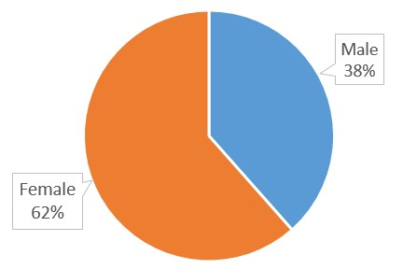
A pie chart could be used to illustrate these figures nicely and shows at a glance that there are more females than males.
Figure 2.5 Sample pie chart showing counts in each category as percentage
Ch 2: Data Visualization – Frequency Histograms

Slide 15
Example:
Many communities add fluoride to water to prevent tooth decay.
In a 25-day period, these levels of fluoride were measured: 75, 86, 84, 85, 97, 94, 89, 84, 83, 89, 88, 78, 77, 76, 82, 72, 92, 105, 94, 83, 81, 85, 97, 93, 79.
Create an appropriate frequency histogram representing this data.
Ch 2: Data Visualization – Frequency Histograms
Notes:
In this example we could generate our frequency table manually in an easy manner. But if we have hundreds or thousands of responses, we want to use Excel to generate the frequency table and associated chart automatically.
First, however, we will work out a slightly more elaborate frequency histogram manually.

Slide 16
Group the data into six categories that we will call bins.
The smallest data value is 72, the largest is 105, so that the width of each bin should be (105 - 72)/6 = 5.5
Next we count how many of our data values will fall in each bin.
If a number should fall on a boundary between two bins, we will decide to count it in the lower bin if possible.
72.0 to 72.0 + 5.5 = 77.5
77.5 to 77.5 + 5.5 = 83.0
83.0 to 83.0 + 5.5 = 88.5
88.5 to 88.5 + 5.5 = 94.0
94.0 to 94.0 + 5.5 = 99.5
99.5 to 99.5 + 5.5 = 105.0
Ch 2: Data Visualization – Frequency Histograms
Notes:
There are too many numbers for a pie or bar chart; in fact we are not interested in the actual numbers as much as we are interested in the frequency with which they occur.
Hence, we want to group them into categories, and then graph the frequency counts of these categories instead of the original numbers.

Slide 17
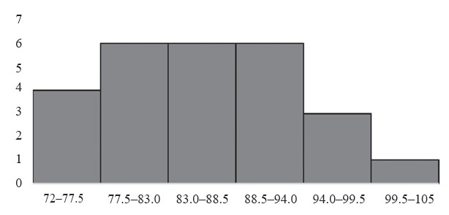
Table 2.1 Frequencies of fluoride levels in water supplies (in parts per billion [ppb])
Figure 2.6 A frequency histogram
Bin | Data | Frequency
less than 77.5 | 75, 77, 76, 72 | 4
77.5–83.0 | 83, 78, 82, 83, 81, 79 | 6
83.0–88.5 | 86, 84, 85, 84, 88, 85 | 6
88.5–94.0 | 94, 89, 89, 92, 94, 93 | 6
94.0–99.5 | 97, 97 | 2
more than 99.5 | 105 | 1
To distinguish a frequency histogram from a bar chart we set the gap between the columns to zero.
Ch 2: Data Visualization – Frequency Histograms
Notes:
A frequency histogram, in addition to being able to assign probabilities to certain events, also tells you the type of distribution of your variable: homogeneous or heterogeneous.
For this example, the variable is heterogeneous.

Slide 18
Example:
Open the Excel spreadsheet linked in the following text.
It shows the age of respondents to a survey.
Generate a frequency histogram and determine if the variable is homogeneous or hetero-geneous.
Use the default number of categories Excel comes up with.
www.betterbusinessdecisions.org/data/math1101_survey_numeric.xls
Ch 2: Data Visualization – Frequency Histograms

Slide 19
The data in that file has the following format:
Ch 2: Data Visualization – Frequency Histograms

Slide 20
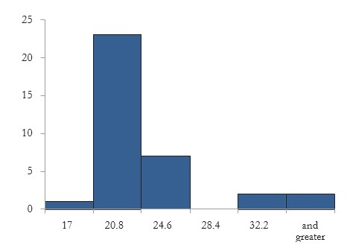
Figure 2.7 Frequency histogram as generated by Excel’s histogram tool
Most values are between 20.8 and 24.6. Thus, most values are pretty similar so that this is a homogeneous distribution.
Another way to look at this is to say that if we meet a random member of this survey, that person is most likely between 20.8 and 24.6 years old.
Ch 2: Data Visualization – Frequency Histograms

Slide 21
Example:
The next Excel spreadsheet contains data for salaries of almost 20,000 Major League Baseball (MLB) players from 1988 to 2011.
Open the data files and create a histogram for the salary variable. Think about whether it is actually a good idea to create this histogram.
www.betterbusinessdecisions.org/data/MLBPlayerSalaries.xlsx
Ch 2: Data Visualization – Frequency Histograms

Slide 22
This data set consists of salary information for almost 20,000 MLB players. It has the following format:
Ch 2: Data Visualization – Frequency Histograms

Slide 23
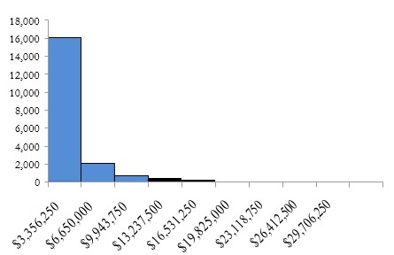
This histogram shows again a homogeneous distribution with most players making less than $3.3 million.
This diagram is accurate but it does not tell the whole story because it ignores the fact that players’ salaries typically increased over the years.
Figure 2.8 Frequencies of MLB salary information
Ch 2: Data Visualization – Frequency Histograms
Notes:
Using Excel’s histogram tool with 10 bins, defined manually, gives the histogram shown in Figure 2.8 (you might want to jump to the “Using Microsoft Excel” section to see how to use Excel’s histogram tool, and then return here).
This diagram is accurate but it does not tell the whole story because it ignores the fact that players’ salaries typically increased over the years.
A more accurate analysis would perhaps create several histograms, maybe one per decade.
That would give a more accurate picture of how salaries changed over time and how they are distributed in each decade.

Slide 24
Relative Frequency Histograms
Example:
Convert the frequencies in Table 2.1 showing the level of fluoride in drinking water to obtain show relative frequencies.
How often did the fluoride level go beyond 94 ppb?
Ch 2: Data Visualization – Relative Frequency Histograms
Notes:
The preceding charts and tables have used the count, or frequency, of each category.
In most cases, though, we are not interested in the raw numbers but in relative frequencies.

Slide 25
Table 2.2 Frequencies and relative frequencies
Bin | Frequency
72.0 - 77.5 | 4
77.5 - 83.0 | 6
83.0 - 88.5 | 6
88.5 - 94.0 | 6
94.0 - 99.5 | 2
99.5 - 105 | 1
Total | 25
Bin | Frequency | Relative Frequency %
72.0 - 77.5 | 4 | 4/25=16
77.5 - 83.0 | 6 | 6/25=24
83.0 - 88.5 | 6 | 6/25=24
88.5 - 94.0 | 6 | 6/25=24
94.0 - 99.5 | 2 | 2/25=8
99.5 - 105 | 1 | 1/25=4
Total | 25 | 100
Recall the data from that example (see Table 2.2 on the left).
Clearly shows that the fluoride level went beyond 94 ppb on three days (but that raw count tells us little)
To interpret it and to put it in perspective we need to relate it to the total number of days that measurements were taken.
In this case, the level went above 94 ppb on 3 out of 25 days, or 12 percent of the time.
We can convert each frequency into a relative frequency by dividing it by the sample size n, as in Table 2.2 on the right.
Ch 2: Data Visualization – Relative Frequency Histograms
Notes:
Usually we are interested in relative frequencies, since they put the raw count in perspective.
However, if the sample size is particularly small, relative frequencies can be misleading.

Slide 26
Example:
A sample of size 3 was selected from a survey of teacher evaluations. Two respondents were male and one was female.
Discuss the merits of relative versus raw frequencies.
The relative frequencies of the sample are clear: 33 percent of the samples were female and 67 percent were male.
This seems to suggest that about 33 percent of all evaluations were submitted by females, 67 percent by males.
Ch 2: Data Visualization – Relative Frequency Histograms

Slide 27
However, since the sample size is so small, these figures are likely to be incorrect.
Thus, if the sample size is small, relative frequencies might convey a false sense of certainty.
Perhaps a reasonable solution is to state the relative frequency as a ratio, not in percentage.
In other words, one out of three evaluations was female and two out of three were male.
Ch 2: Data Visualization – Relative Frequency Histograms

Slide 28
Example:
Consider the same data set of MLB salaries and create a relative frequency table and corresponding histogram for the salaries in 2011 only.
How many players, approximately, made less than $13 million in 2011?
To create a relative frequency table:
We first create a standard frequency table
Then we convert each frequency into a relative frequency by dividing it by the sample size.
Ch 2: Data Visualization – Relative Frequency Histograms

Slide 29
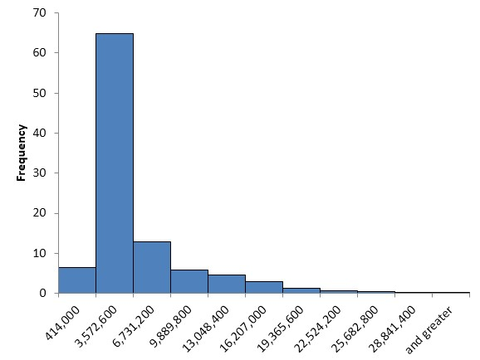
Figure 2.9 shows the resulting table, using 10 categories, of MLB salaries in 2011:
Bin ($) | Frequency | Relative Frequency %
414,000 | 55 | 6.5
3,572,600 | 546 | 64.8
6,731,200 | 109 | 12.9
9,889,800 | 49 | 5.8
13,048,400 | 38 | 4.5
16,207,000 | 25 | 3
19,365,600 | 11 | 1.3
22,524,200 | 5 | 0.6
25,682,800 | 3 | 0.4
28,841,400 | 1 | 0.1
and greater | 1 | 0.1
 | 843 | 100.0
Figure 2.9 Relative frequencies of MLB salaries in 2011
We added a column containing the relative frequencies by dividing each frequency by the sample size n = 843.
Now it is easy to see that approximately 6.5 + 64.8 + 12.9 + 5.8 = 90% of MLB players made less than $13 million in 2011.
Ch 2: Data Visualization – Relative Frequency Histograms
Notes:
Note that a frequency histogram and a relative frequency histogram will have the exact same shape. The only difference between the two would be the scale on the (vertical) y-axis.

Slide 30
Cumulative Frequency Histograms
the sum of the relative frequencies up to the given bin
Example:
Consider the salaries of MLB players in 2011 and add cumulative frequencies to the table.
Ch 2: Data Visualization – Cumulative Frequency Histograms

Slide 31
Table 2.3 Relative and cumulative frequency table for MLB salaries in 2011
To compute the cumulative frequency for a row:
We add the relative frequencies up to and including that row
Or equivalently we add the current relative frequency to the prior cumulative frequency
Bin ($) | Frequency | Relative frequency (%) | Cumulative frequency (%)
414,000 | 55 | 6.5 | 6.5
3,572,600 | 546 | 64.8 | 6.5 + 64.8 = 71.3
6,731,200 | 109 | 12.9 | 71.3 + 12.9 = 84.2
9,889,800 | 49 | 5.8 | 84.2 + 5.8 = 90.0
13,048,400 | 38 | 4.5 | 90.0 + 4.5 = 94.5
16,207,000 | 25 | 3.0 | 94.5 + 3.0 = 97.5
19,365,600 | 11 | 1.3 | 97.5 + 1.3 = 98.8
22,524,200 | 5 | 0.6 | 98.8 + 0.6 = 99.4
25,682,800 | 3 | 0.4 | 99.4 + 0.4 = 99.8
28,841,400 | 1 | 0.1 | 99.8 + 0.1 = 99.9
and greater | 1 | 0.1 | 99.9 + 0.1 = 100
 | 843 | 100.0
Ch 2: Data Visualization – Cumulative Frequency Histograms
Notes:
We already saw that relative frequencies translate to probabilities. Cumulative frequencies, on the other hand, will be useful to find median, quartiles, and percentiles (see Chapter 3).
Excel provides a number of additional charts as well as variations on existing types. It is easy to experiment so feel free to check out other types of charts.

Slide 32
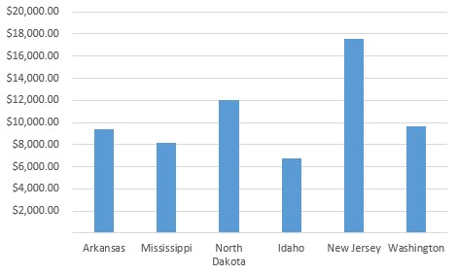
Bending the Rules: Lying or Exaggeration
Table 2.4 Money spent per student in select states in 2013
Figure 2.10 Standard bar chart representing money spent per student in 2013
State | $ per student
Arkansas | 9,394
Mississippi | 8,130
North Dakota | 11,980
Idaho | 6,791
New Jersey | 17,572
Washington | 9,672
It is easy to see that of the states listed, New Jersey (NJ) spends the most per student, about twice as much as states like Arkansas (AR) or Mississippi (MS).
The difference between NJ and AR is pretty clear.
Ch 2: Data Visualization – Bending the Rules: Lying or Exaggeration
Notes:
Using graphical data representation provides a great opportunity to visualize data so that it conveys a particular point of view.
This is not cheating; it is simply using some visual aids to make your data appear to support one particular point of view over another without actually changing the data.

Slide 33
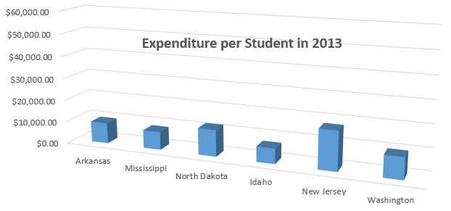
Now suppose we want to give a presentation in which the state of AR is supposed to look reasonably good as compared to the state of NJ.
Create a bar chart that minimizes the visual differences in state spending by using a particularly “large” scale on the y-axis
De-emphasizing the empty space that results in choosing a large y-scale by placing the chart title into that area
In this chart it is still clear that NJ spends the most per student—after all, we cannot change the actual data—but the difference does not look quite so stark any more.
Figure 2.11 Spending per student, de-emphasizing differences between states
Ch 2: Data Visualization – Bending the Rules: Lying or Exaggeration
Notes:
As another option, we could remove the horizontal gridlines to make it harder to see exactly how much money the different states actually spend.

Slide 34
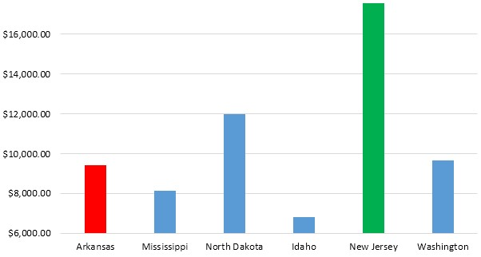
Try the opposite: a presentation in which the state of AR looks bad as compared to the state of NJ
Pick a scale on the y-axis that makes sure that the difference between AR and NJ appears as large as possible
Choose a y-scale that starts at 6,000 and ends at 17,600 instead of the standard values
Pick an “aggressive” color (such as red) for the AR figure and a “calm” color (such as green) for NJ, emphasizing the fact that we want to represent AR as “bad” and NJ as “good.”
Figure 2.12 Spending per student, emphasizing the difference between AR and NJ
Ch 2: Data Visualization – Bending the Rules: Lying or Exaggeration
Notes:
In this chart AR indeed looks pretty bad compared to NJ—in fact, it seems as if NJ spends many times more money per student than AR—but we have not changed the actual data values.
All three charts represent the same data and are perfectly valid. Yet visually they tell different stories.
There are many other tricks that can be used to represent data in such a way as to support one particular point of view without outright changing the data.

Slide 35
Exercise:
Suppose you have some data showing the cases of H1N1 influenza infections per region as follows:
Region 01—Boston: 215
Region 02—New York: 229
Region 03—Philadelphia: 193
Region 04—Atlanta: 301
Region 05—Chicago: 1,788
Region 06—Dallas: 734
Region 07—Kansas City: 164
Region 08—Denver: 175
Region 09—San Francisco: 1,080
Region 10—Seattle: 420
Ch 2: Data Visualization – Bending the Rules: Lying or Exaggeration
Notes:
If you were a health official in Dallas, you might want to use this data to try to get people in your region to vaccinate against the H1N1 flu or to encourage a government agency to fund prevention and treatment programs in Dallas.
Thus, you are trying to create a chart that emphasizes the number of cases in Dallas versus the other regions so that your citizens are motivated to get vaccinated or that funding is approved. Figure 2.13 shows a few suggestions.
Try this: check your local newspaper or online news source to find some charts. See if these charts try to promote any particular point of view or if they are relatively neutral.

Slide 36
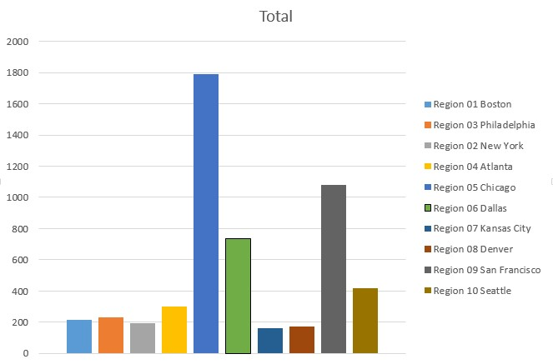
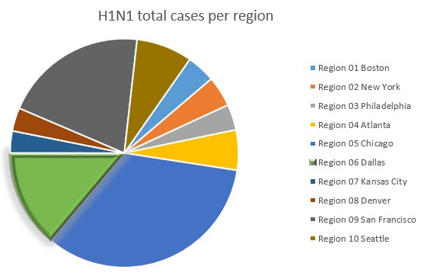
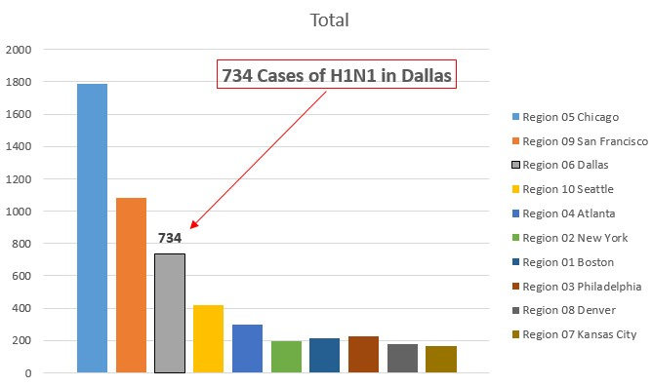
Figure 2.13 Tricks to highlight a particular data point without changing the data
Ch 2: Data Visualization – Bending the Rules: Lying or Exaggeration

Slide 37
Using Microsoft Excel – Creating Charts
Table 2.5 Poverty and crime data for New England states in 2009
Example
Table 2.5 shows the percentage of the population living in poverty and the violent crime rate per 100,000 people in 2009 (from census.gov) in the six New England states. Decide if a bar chart or pie chart is better to represent the data.
State | Poverty | Crime
Connecticut | 9.4 | 306.7
Maine | 12.3 | 119.4
Massachusetts | 10.3 | 466.2
New Hampshire | 8.5 | 166
Rhode Island | 11.5 | 252.8
Vermont | 11.4 | 140.8
Ch 2: Data Visualization – Using Microsoft Excel – Creating Charts

Slide 38
Note that the following instructions are for Excel 2013 but other versions of Excel offer similar capabilities.
Enter the data into an empty spreadsheet in Excel.
Use the mouse (or cursor keys while holding SHIFT) to select the cells in the first two columns, including the first row containing the variable names; ignore the third column for now.
Select the “Insert” ribbon.
You should see an icon for “recommended chart” as well as icons for specific chart types. It is usually a good idea to check the recommended chart.
In our case, though, we know which chart type we want, so we directly click on the pie chart icon and select the “3D” subtype.
Ch 2: Data Visualization – Using Microsoft Excel – Creating Charts
Notes:
We have only six categories for our data, so neither a bar chart nor a pie chart can be excluded. We will create both to see which one seems more meaningful.

Slide 39
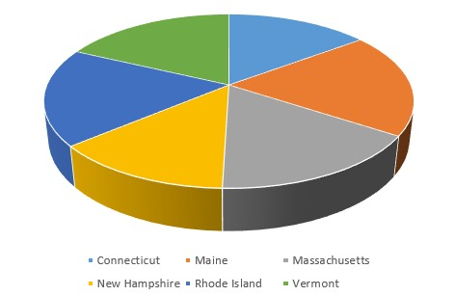
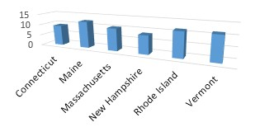
Figure 2.14 Poverty data for New England states in a pie chart (left) and a bar chart (right)
The pie chart – not very helpful
difficult to grasp which slice represents what state and it is difficult to see the actual poverty rate for each slice
Excel recommends pie charts if the various category values add to 100 percent
The bar chart has more potential but at the moment it is not looking its best.
Ch 2: Data Visualization – Using Microsoft Excel – Creating Charts
Notes:
While you hover over a particular chart type you will see a preview of the chart.
In our case the 3D pie chart for the variable poverty is shown in Figure 2.14 on the left.
We repeat the procedure to produce a 3D column bar chart, shown on the right in Figure 2.14.

Slide 40
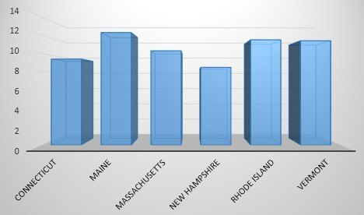
Click on the chart title “Poverty” and press Delete.
The title will disappear and the chart will grow slightly.
Excel offers some “styles” on the “Insert” ribbon that can further improve the look of a chart.
We pick, for example, the third option called “style 3” to get a nicely formatted, readable chart as shown in Figure 2.15.
Figure 2.15 Nicely formatted bar chart for poverty data
Ch 2: Data Visualization – Using Microsoft Excel – Creating Charts

Slide 41
To create a chart for the “crime” variable we first switch the second and third columns with each other via cut and paste—for simple charts it is easiest to make sure that the data and the labels are next to each other.
If you select all three columns, Excel will recommend a “stacked” chart, which is not appropriate for this data.
Alternatively, you could use the cursor keys together with CTRL to select the non-adjacent columns “State” and “Crime.”
For additional help and information, see “How to use the Chart Wizard,” available at https://support.microsoft.com/en-us/kb/304421
Ch 2: Data Visualization – Using Microsoft Excel – Creating Charts

Slide 42
Excel’s Histogram Tool
Example
Many communities add fluoride to water to prevent tooth decay. In a 25-day period, these levels of fluoride were measured: 75, 86, 84, 85, 97, 94, 89, 84, 83, 89, 88, 78, 77, 76, 82, 72, 92, 105, 94, 83, 81, 85, 97, 93, 79.
Create an appropriate frequency histogram representing this data, using the appropriate Analysis ToolPak tool.
Ch 2: Data Visualization – Excel’s Histogram Tool
Notes:
The Analysis ToolPak provides a convenient tool to create histograms for numerical variables.

Slide 43
Here is a quick walk-through of this procedure:
Start Excel and enter the preceding numbers, all in one column.
You do not need to enter a title or anything else, just the numbers in one column, one number in each row.
Bring up the “Data Analysis ...” dialog (remember, it is available on the “Data” ribbon). If you do not see this item, you must first install the “Analysis ToolPak” as described in Chapter 1.
You will see a dialog box listing all procedures available in this Analysis ToolPak. Highlight the entry “Histogram”; then click “OK.”
Next, enter the options for a (frequency) histogram, including the location of the data to use and, optionally, the categories (bin ranges) that you want to define. See Figure 2.16 for details.
Ch 2: Data Visualization – Excel’s Histogram Tool

Slide 44
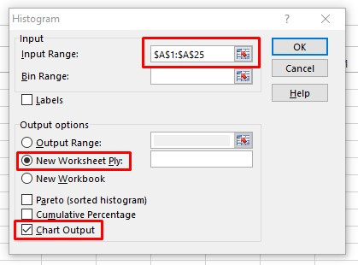
To define the input range, you can use the “cell selector” icon next to the “Input Range” field.
Click it and use the mouse or cursor keys to select the appropriate cells by highlighting them.
Click the “Return” icon to return to the original “Histogram” dialog box.
Leave the “Bin Range” empty for now so that the tool will automatically pick the bins for the data.
Make sure to check “New Worksheet Ply” as your output options, check the “Chart Output,” and click OK.
Figure 2.16 Options for the histogram procedure in Analysis ToolPak
Note that if your first cell contained a variable label instead of the first value, you would need to check the “Labels” option as well.
Ch 2: Data Visualization – Excel’s Histogram Tool

Slide 45
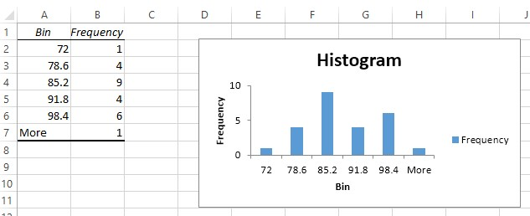
Figure 2.17 A histogram with automatically generated bins
Ch 2: Data Visualization – Excel’s Histogram Tool

Slide 46
As usual, we can now customize our chart by double-clicking on its components to replace the various titles by more meaningful names, and removing the “Frequency” label.
In this example Excel determined the categories for our numerical variable (the “bins”) automatically.
If we want to define the bin boundaries manually, we would add the numbers representing the bin boundaries in increasing order somewhere in a column and select them by clicking the cell selector icon in the “Bin Range” field.
Category 1
includes all numbers less than 72 and includes one measurement
Category 2
goes from 72 to 78.6 and includes four measurements
Category 3
goes from 78.6 to 85.2 and includes nine measurements
Category 4
goes from 85.2 to 91.8 and includes four measurements
Category 5
goes from 91.8 to 98.4 and includes six measurements
Category 6
includes everything above 98.4 and includes one measurement
Ch 2: Data Visualization – Excel’s Histogram Tool

Slide 47
Example
Use Excel to create another histogram for the fluoride data that has four bins.
We need to determine the boundaries of the bins so that we end up with exactly four bins.
We can use Excel’s =min(RANGE) and =max(RANGE) functions to determine the smallest and largest data point.
Then, if we use bins with width of (max - min)/(number of bins), we will end up with the right number of equally spaced bins:
min = 72, max = 105, bin width = (105 - 72)/4 = 8.25
Ch 2: Data Visualization – Excel’s Histogram Tool

Slide 48
Now we add a column to the Excel table where we define the bin boundaries:
Note that we need three bin boundaries to define four bins:
Finally, start the histogram procedure from our Analysis ToolPak.
Define the data range as usual, but also define as bin range the three bin boundaries we just computed.
The resulting histogram will now have four bars, as desired.
min + width = 80.25
min + 2 * width = 88.5
min + 3 * width = 96.75
less than 80.25
between 80.25 and 88.5
between 88.5 and 96.75
bigger than 96.75
Ch 2: Data Visualization – Excel’s Histogram Tool

Slide 49
Example
Consider the Excel spreadsheet containing salary data of almost 20,000 MLB players from 1988 to 2011.
Create a histogram for the salary variable with 10 equally spaced bins.
www.betterbusinessdecisions.org/data/MLBPlayerSalaries.xlsx
Ch 2: Data Visualization – Excel’s Histogram Tool

Slide 50
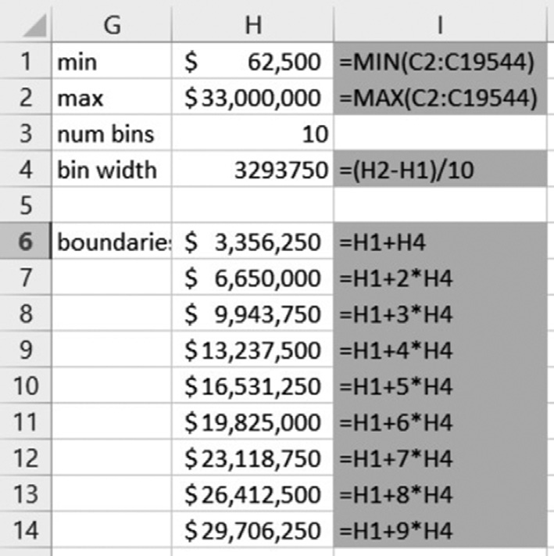
First compute the minimum and maximum data values and then use them to define the bin widths for our bins.
Finally create 9 bin boundaries to define our 10 bins, letting Excel do the actual computations (see Figure 2.18).
With these boundaries in place, start the histogram tool as usual.
Enter the range for the salary data C2:C19544 and use the boundaries we just computed as bin range (H6:H14).
Make sure the option for “Chart Output” is checked to generate this histogram chart in addition to the table.
The resulting histogram should look like the one in Figure 2.8.
Figure 2.18 Computing bin boundaries for MLB data
Ch 2: Data Visualization – Excel’s Histogram Tool

Slide 51
Excel’s Pivot Tool: Charts for Categorical Data
Example
A survey was conducted in the summer of 2014, asking several students in a statistics course a number of questions about their background and musical taste.
The data can be found by clicking on the following link.
Display a bar chart for the race of the students. In other words, compute how many of the students are White, Black, Hispanic, and so on and display those figures in a bar chart.
www.betterbusinessdecisions.org/data/student-survey.xls
Ch 2: Data Visualization – Excel’s Pivot Tool: Charts for Categorical Data
Notes:
Often one would like to know the frequency of occurrence of values for a variable in percentage.
This is similar to a frequency histogram we studied earlier, but a histogram only applies to numerical variables, while the procedure outlined in this section applies to categorical variables.

Slide 52
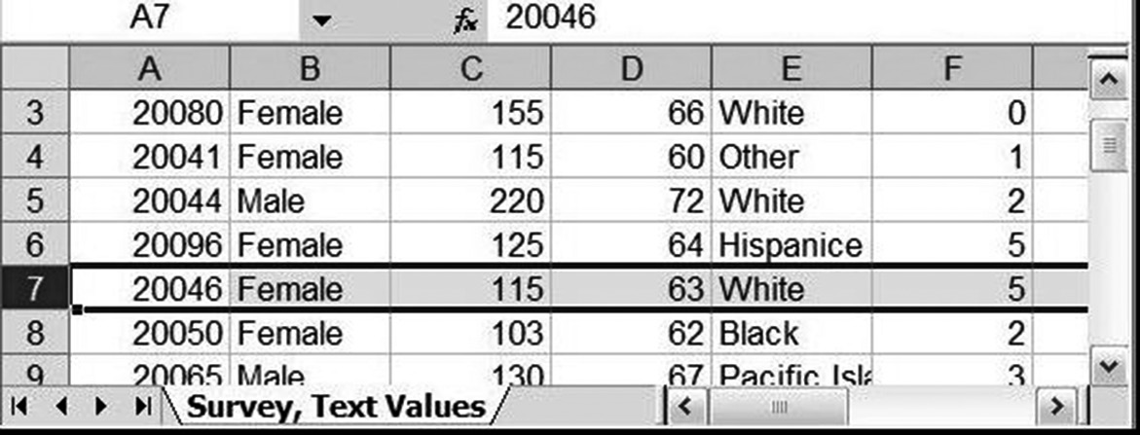
Loading this data into Excel, we see in Figure 2.19 that the column of interest is column E titled “Race.”
However, that column represents a categorical variable (ordinal or nominal?), so we cannot compute a frequency histogram.
Figure 2.19 Excerpt of data from a student survey
Ch 2: Data Visualization – Excel’s Pivot Tool: Charts for Categorical Data

Slide 53
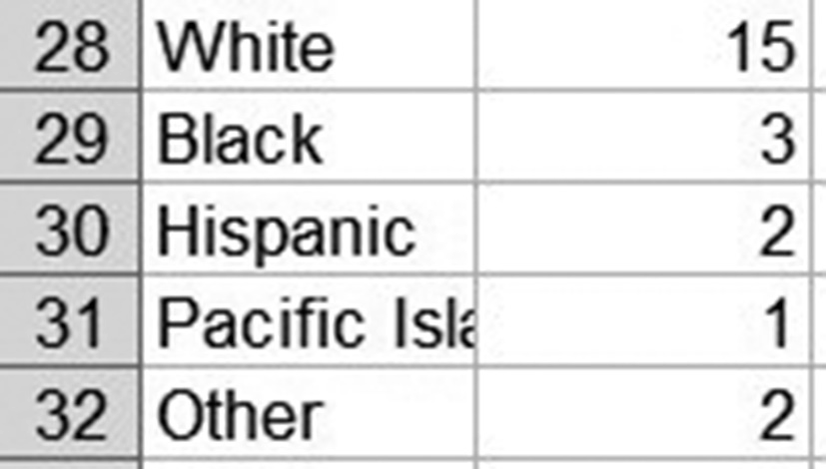
Before we figure out how Excel can generate the desired data automatically let us do it by hand.
Inspecting the data we see that there are five categories: White, Black, Hispanic, Pacific Islander, and Other.
We can manually count how many people are contained in each category (see Figure 2.20).
Figure 2.20 A frequency table generated manually
Ch 2: Data Visualization – Excel’s Pivot Tool: Charts for Categorical Data

Slide 54
To use the pivot tool:
Load the preceding spreadsheet into Excel and click anywhere outside the data area
For example, below the last row of data (otherwise the pivot tool may be disabled)
Select “Insert | Pivot Table” and choose the entire data table for the Input Range field, using the by now familiar range selector.
Make sure to pick the entire data table, including the first row containing labels.
Excel should by default have selected the entire table already for your convenience.
Choose to put the resulting pivot table into a new spread- sheet and click “Okay” to generate the pivot table, which will initially be empty.
Ch 2: Data Visualization – Excel’s Pivot Tool: Charts for Categorical Data
Notes:
For large data sets we need to figure out an automatic procedure to generate the appropriate table.
Fortunately, Excel has just such a procedure, called a Pivot Table. The pivot tool is found as the first button of the “Insert” ribbon.

Slide 55
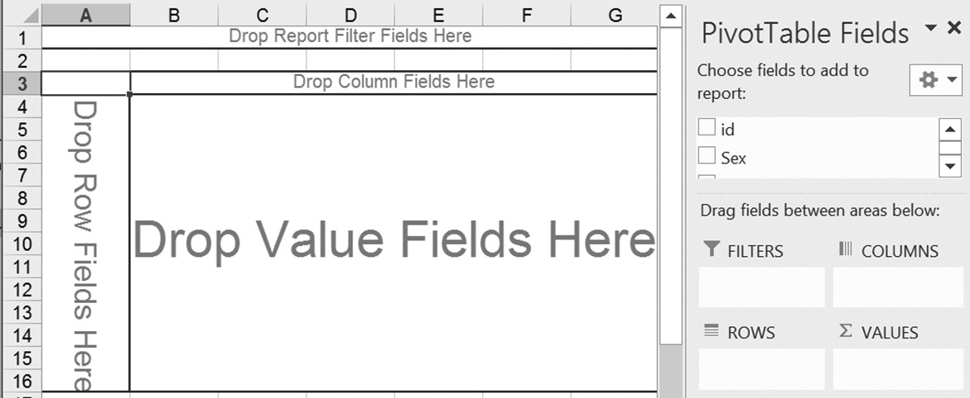
You will see a “potential frequency table” containing labels such as “Drop Row Field Here,” “Drop Column Fields Here,” and so on, but no data values are yet contained in the table.
Drag the variable “Race” from the field list into the “Drop Row Fields” area of the table.
Your table will adjust, showing you all available “Race” categories but as for now no frequencies (counts).
Next, again drag the variable “Race” from the field list, but this time drag it to the “Drop Value Fields” area in the middle.
Figure 2.21 An empty pivot table with a list of named fields
Ch 2: Data Visualization – Excel’s Pivot Tool: Charts for Categorical Data
Notes:
There will also be a list containing the available variables from your data, in our case “id,” “Sex,” “Weight,” “Height,” “Race,” and so on.
You can “drag and drop” these variables onto the various slots in the table to create a variety of useful tables for data analysis.

Slide 56
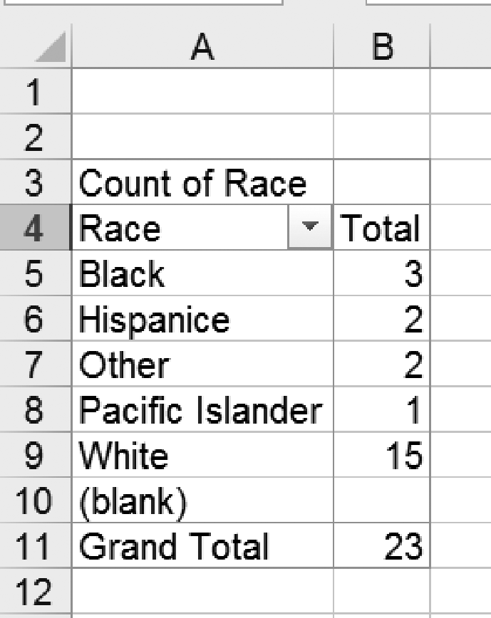
You will now see the counts of how many occurrences fell inside each race category, which of course will turn out similar to the one we created manually before in Figure 2.17, except this time it includes the “blank” category (and the order may be different).
Figure 2.22 A pivot table showing the counts in the race categories
Ch 2: Data Visualization – Excel’s Pivot Tool: Charts for Categorical Data

Slide 57
See if you can eliminate the “blank” response row.
Hint: Maybe you can find a drop-down menu somewhere where you can “uncheck” unwanted categories.
Also, when you double-click the “Count of Race” label in the table you can specify exactly what type of counts should be shown and in which way it should be formatted.
Try, for example, to get your counts to appear as percentage of the overall total.
You can now create a bar chart as usual, including or excluding the blank response as you see fit.
Ch 2: Data Visualization – Excel’s Pivot Tool: Charts for Categorical Data

