Slide 1

ITERATIVE DYNAMIC SYSTEMS THROUGH
THE MANDELBROT AND JULIA SETS
Jonathan Arena
and
Joseph O’Connor

Slide 2

Iterative Dynamic Systems
Start with a function f(z) in the complex plane and consider the orbit of a starting point (seed) z₀
  O_{f}(z₀ ) = { z_{n+1} = f(z_{n}) for some starting point z₀}
  = {z₀, f(z₀), f(f(z₀)),…}
  = {z₀, z₁, z₂,…}
Study the convergence behavior
of this sequence of
iterated points

Slide 3
Example: f(z)=z²
O_{f}(0) = {0, f(0), f(f(0)), f(f(f(0))), … } = {0, 0, 0, … }
(0 is called a fixed point)
O_{f}(1/2) = {1/2, f(1/2), f(f(1/2)), f(f(f(1/2))), … }
= {1/2, 1/4, 1/16, 1/256, … }
(converges to zero)
O_{f}(2) = {2, f(2), f(f(2)), f(f(f(2))), … }
= {2, 4, 16, 256, … }
(converges to infinity)

Slide 4
Example: f(z)=z²
All points inside the circle converge to 0
All points outside the circle converge to infinity

Slide 5
Family of Functions: f_{c}(z)=z²+c
Two basic Questions:
Fix a parameter c and study the orbits of z₀ for varying z₀
    => Julia sets (Gaston Julia, 1893 – 1978)
Fix a seed z₀ and study the orbits of that seed as the parameter c changes.
    => Mandelbrot set (Benoit Mandelbrot, 1924 – 2010)

Slide 6
Julia Sets (fixing c)
The filled-in Julia set is the set of all bounded orbits
J_{c} = {z: orbits under f_{c}(z)=z²+c are bounded}
Theorem: J_{c} is never empty because it contains at least the fixed and all periodic points
  f(z) = z (fixed point)
  f(f(z)) = z (period 2 point)
  f(f(f(z))) = z (period 3 point)
  …

Slide 7

Property of the Julia Sets
Theorem: J_{c} is either connected or totally disconnected
Definition of total disconnectedness: A set S is totally disconnected if it has no interior, i.e. there is no path connecting any two points in S.

Slide 8
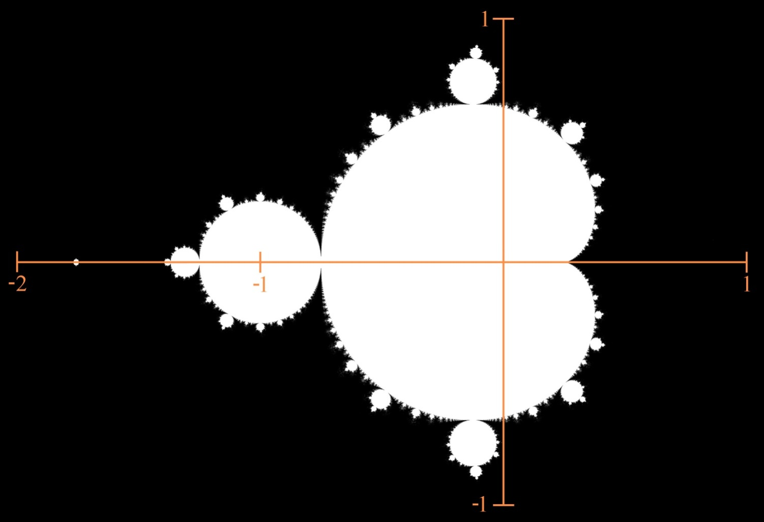
Mandelbrot Set M (fixing z₀)
Definition: M = {c: J_{c} is connected}

Slide 9
Property of the Mandelbrot Set
Theorem: M = {c: J_{c} is connected}
= {c: |f_{c}^{(n)}(0)| is bounded}
  (0 is the critical point for f_{c}(z) = z² + c)
  NOTE: The (single) Mandelbrot set can be considered an “index” for the (many) Julia sets

Slide 10
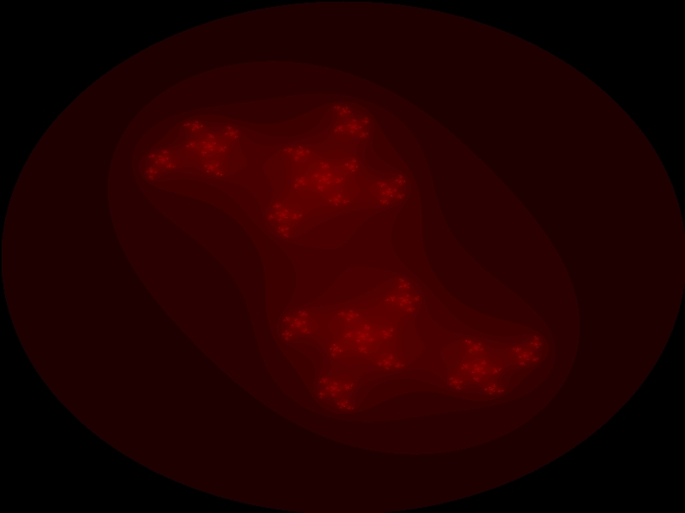

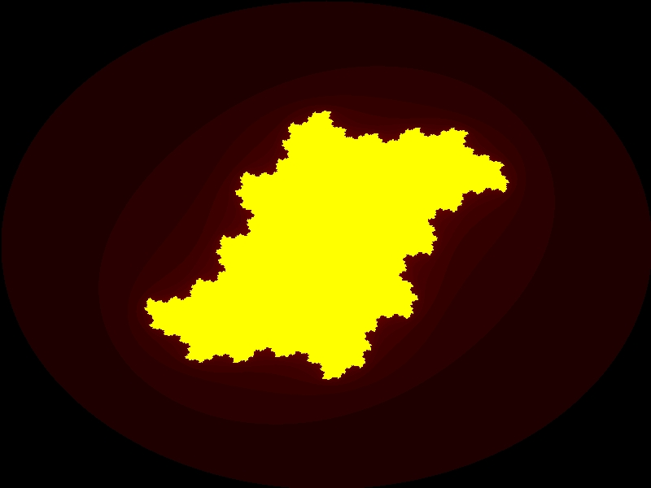
c= 0.25+0.75i
A point that is outside the Mandelbrot set, such as c=0.25 + 0.75i, results in a disconnected Julia set.
Conversely, a point inside the Mandelbrot set, such as c=0.1 – 0.5i, results in a connected Julia set.
c= 0.1-0.5i

Slide 11
Computer Programs
Two programs in Java:
  Create numerous paths through the Mandelbrot set to create various Julia sets, and show these images in quick succession
  Fix different viewing windows for the Mandelbrot set to create zoomed-in images, and show these images in rapid succession

